Slide 1
INCLUSION CONFUSION NO MORE
ITS WASHINGTON, DECEMBER 12, 2022
Notes:
Diana
Hello everyone. My name is Diana Giraldo. I am a Senior Project Manager at HNTB, and the WTS Immediate past president.
I use she/her as my pronouns. I am a light brown colored Hispanic woman, and I’m currently wearing a black blazer on top of a gray shirt with a white necklace graphic.
I am very happy to be here and talk about what we can all do to make our personal and professional lives and spaces more inclusive.
WSDOT asked WTS to put together a program about inclusion back in 2018/2019 for the Innovations conference, when DEI wasn’t quite the established term that it is today, and when companies and individuals were starting to catch up and figure out what inclusion really meant and how to implement it. So at that time, the title of the presentation was “Inclusion Confusion”. Since then, a pandemic happened, and more conversations about Inclusion have taken place, so there should not be confusion per se.
With that, let’s get going.

Slide 2
Agenda
Welcome and context
Introductions
Definitions
Roles for Driving inclusion –
Individual – Owning your story
Company
Leaders
Allies
Q&A
2
Notes:
Diana
This is our agenda for today.
I’ll do quick introductions for our speakers and will also cover some of the terms that we will use throughout the presentation.
I will then turn it over to our speakers to tell us a bit more about themselves and share their stories, and the role they play as individuals in driving diversity.
And the need for everyone to play a role – from the individual, to companies, to leaders, to allies.
And we will end with Q&A

Slide 3
Land Acknowledgment
Every community owes its existence and vitality to generations from around the world who contributed their hopes, dreams, and energy to making the history that led to this moment. Some were brought here against their will, some were drawn to leave their distant homes in hope of a better life, and some have lived on this land for more generations than can be counted.
We would like to acknowledge that we are on the traditional land of the first people of Seattle, the Duwamish people past and present, and that the promises of the 1855 Treaty of Point Elliott remain unfulfilled by the United States. It is because of their sacrifices and hardships that we are able to be here to learn and share knowledge to advance equity.
Visit native-land.ca to see who the Indigenous Tribes and Nations of the place you call home are.
3
Notes:
Diana
”I would like to acknowledge that we are on the traditional land of the first people of Seattle, the Duwamish People past and present and honor with gratitude the land itself and the Duwamish Tribe.”

Slide 4
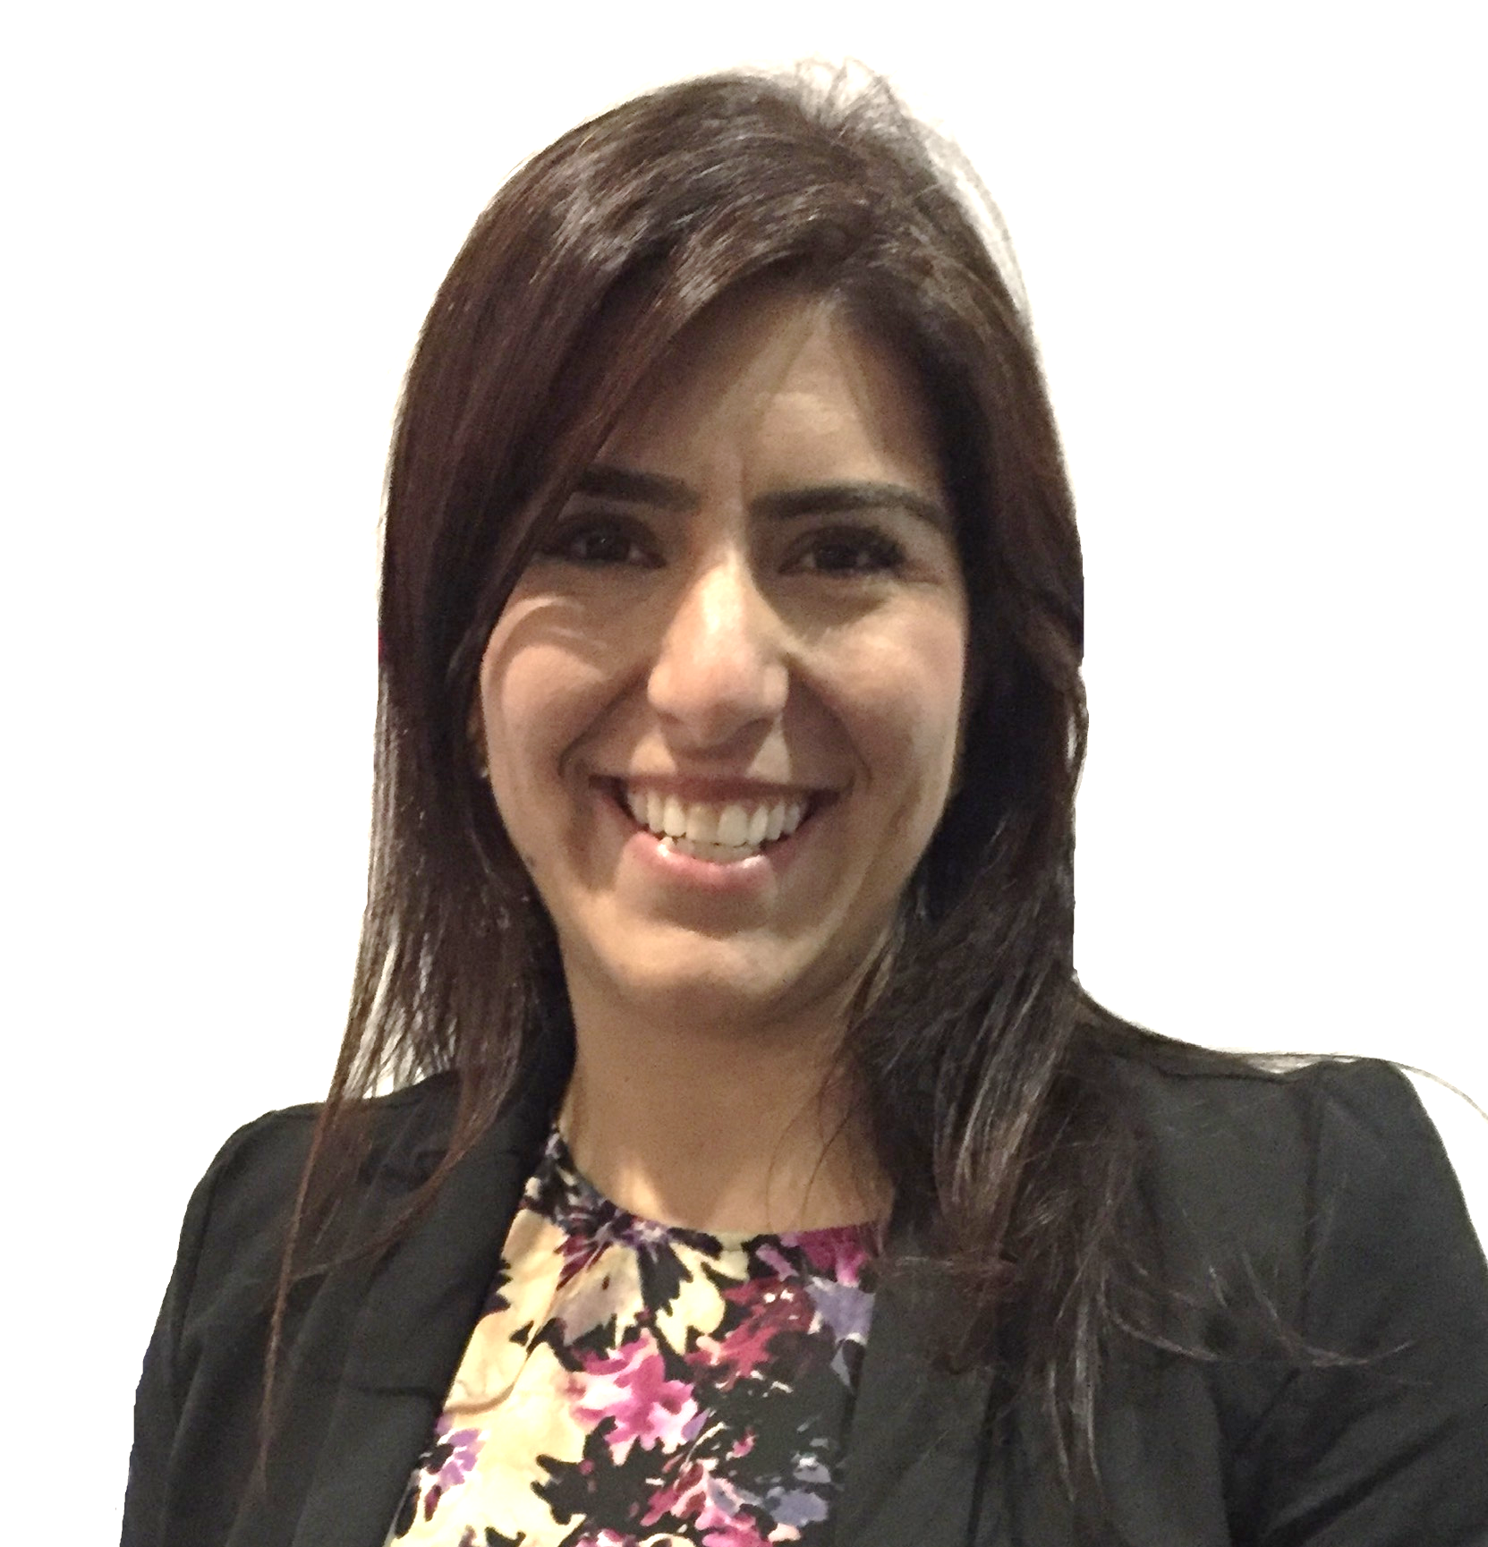
Today’s Speakers
Diana Giraldo, PE, AVP
She/Her
Julien Geiser
He/Him
Brooksie Barton, PE
She/Her
Associate Vice President/ Senior Project Manager
WTS Puget Sound Past President
Organization:
HNTB
Director, Corporate Support
Organization:
Greatheart Consulting
Senior Transportation Engineer/US West Inclusion & Diversity Council Chair
Organization:
Jacobs
4
Notes:
Diana
Diana is a Senior Project Manager and Assistant Vice President with HNTB. She is a Civil Engineer with more than 20 years of experience in design, alternative delivery and project management. Her experience includes leading several projects on the I-405/SR 167 Corridor Program, helping WSDOT deliver a $20-billion multimodal, multiagency transportation vision. Diana is the immediate past president for the WTS Puget Sound/Seattle Chapter and is passionate about equitable transportation.
Brooksie – is part of our DEI committee for WTS. Brooksie Barton is a Senior Transportation Engineer and a Built Environment Group Lead for Jacobs Engineering. She has been involved with Inclusion and Diversity efforts at Jacobs for over 7 years. She started the Bellevue Chapter of the Jacobs Women’s Network, served as the Jacobs US West Regional Lead for the Women’s Network for the past 2 years, Jacobs US West Chair for the TogetherBeyond (Inclusion and Diversity) Council, serves on the WTS Diversity, Equity and Inclusion committee and is a Leadership Tomorrow 2022 alumni.
Julien - Julien Geiser is the Director of Corporate Support at Greatheart Consulting. As an educated, white, cis male in America, he has benefitted both directly and indirectly from vast amounts of compounding historic privilege. As a third-culture kid, he also has direct experience of both belonging and not. It is his passion for culture, people, and building belonging and understanding that drives his passion for DE&I work. He also calls on his experience as a partner, father, Surface Warfare Officer in the Navy, and sustainable designer to help shift cultures towards greater equity and inclusion.
Inclusion Catalyst podcast

Slide 5
Definitions
Diversity is the mix of identities, experiences, and values among people in the organization.
Inclusion is when each person is engaged and can contribute their best because they belong.
Inclusive Leaders create and foster an environment where people feel they belong by listening, caring, building trust, and taking action.
Allies listen, co-create opportunity, and are known for being accountable, keeping their promises, and taking action.
5
Notes:
Diana
Inclusion is a sense of belonging, connection and community at work. ​ ​ Inclusive organizations help people feel welcomed, known, valued -- and encouraged to bring their whole, unique selves to work.
KiMS:
What is Inclusion? The practice or policy of providing equal access to opportunities and resources for people who might otherwise be excluded or marginalized, such as those who have physical or mental disabilities and members of other minority groups.

Slide 6
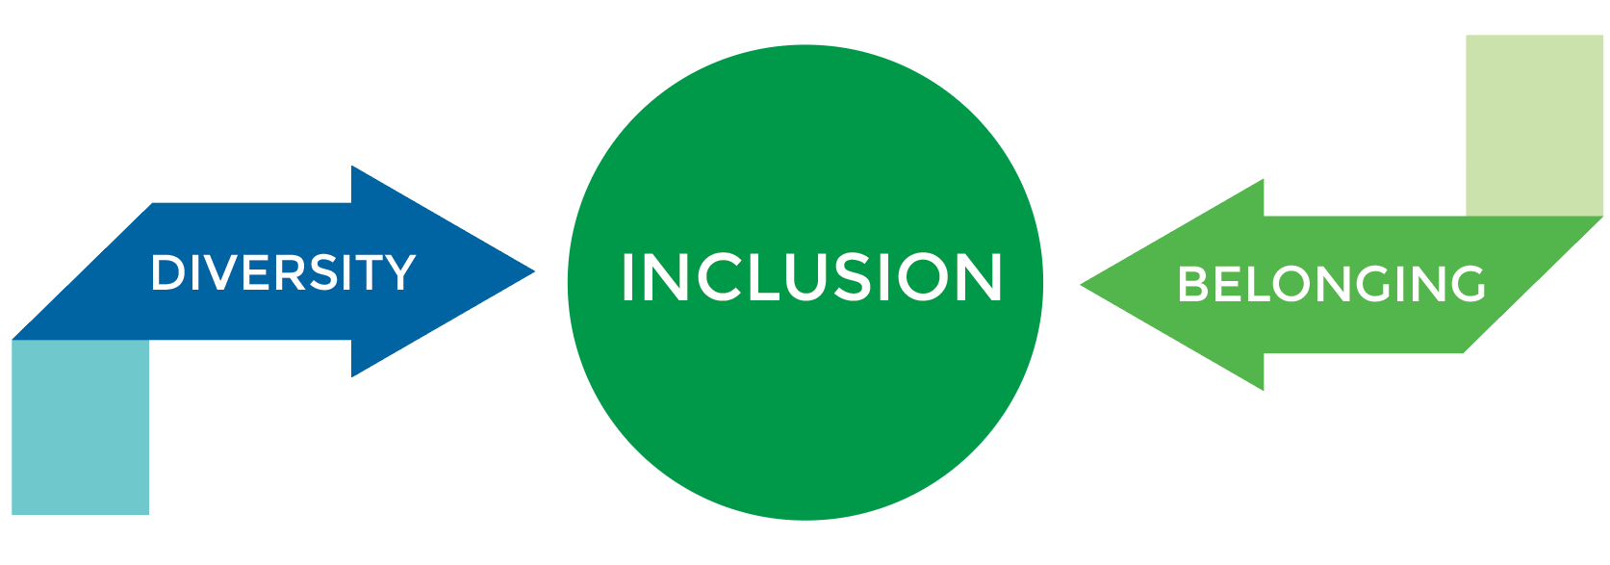
How does it relate to diversity?
A mixture of perspectives, identities, and points of view
A sense of connection, acceptance, and equal influence that is always in the process of being actively achieved
6
Notes:
Diana
Bridging the gap

Slide 7
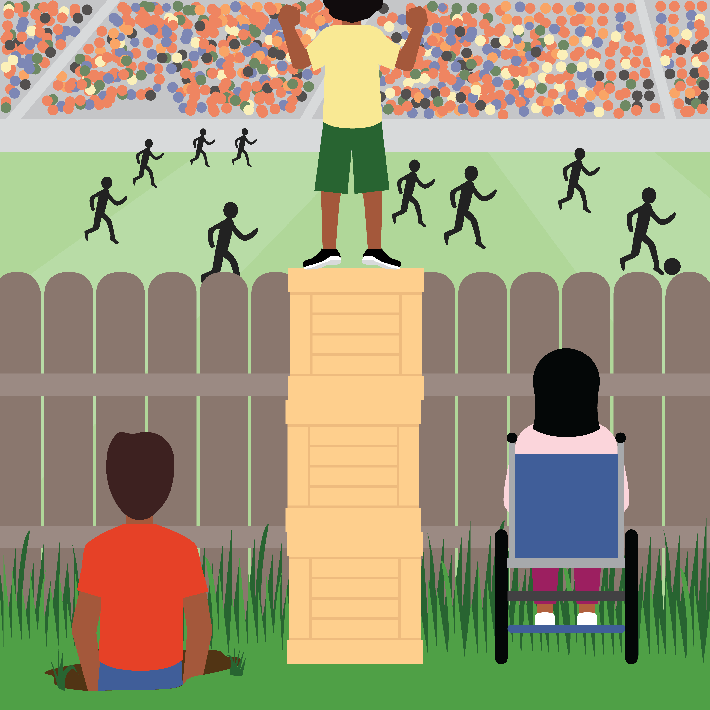
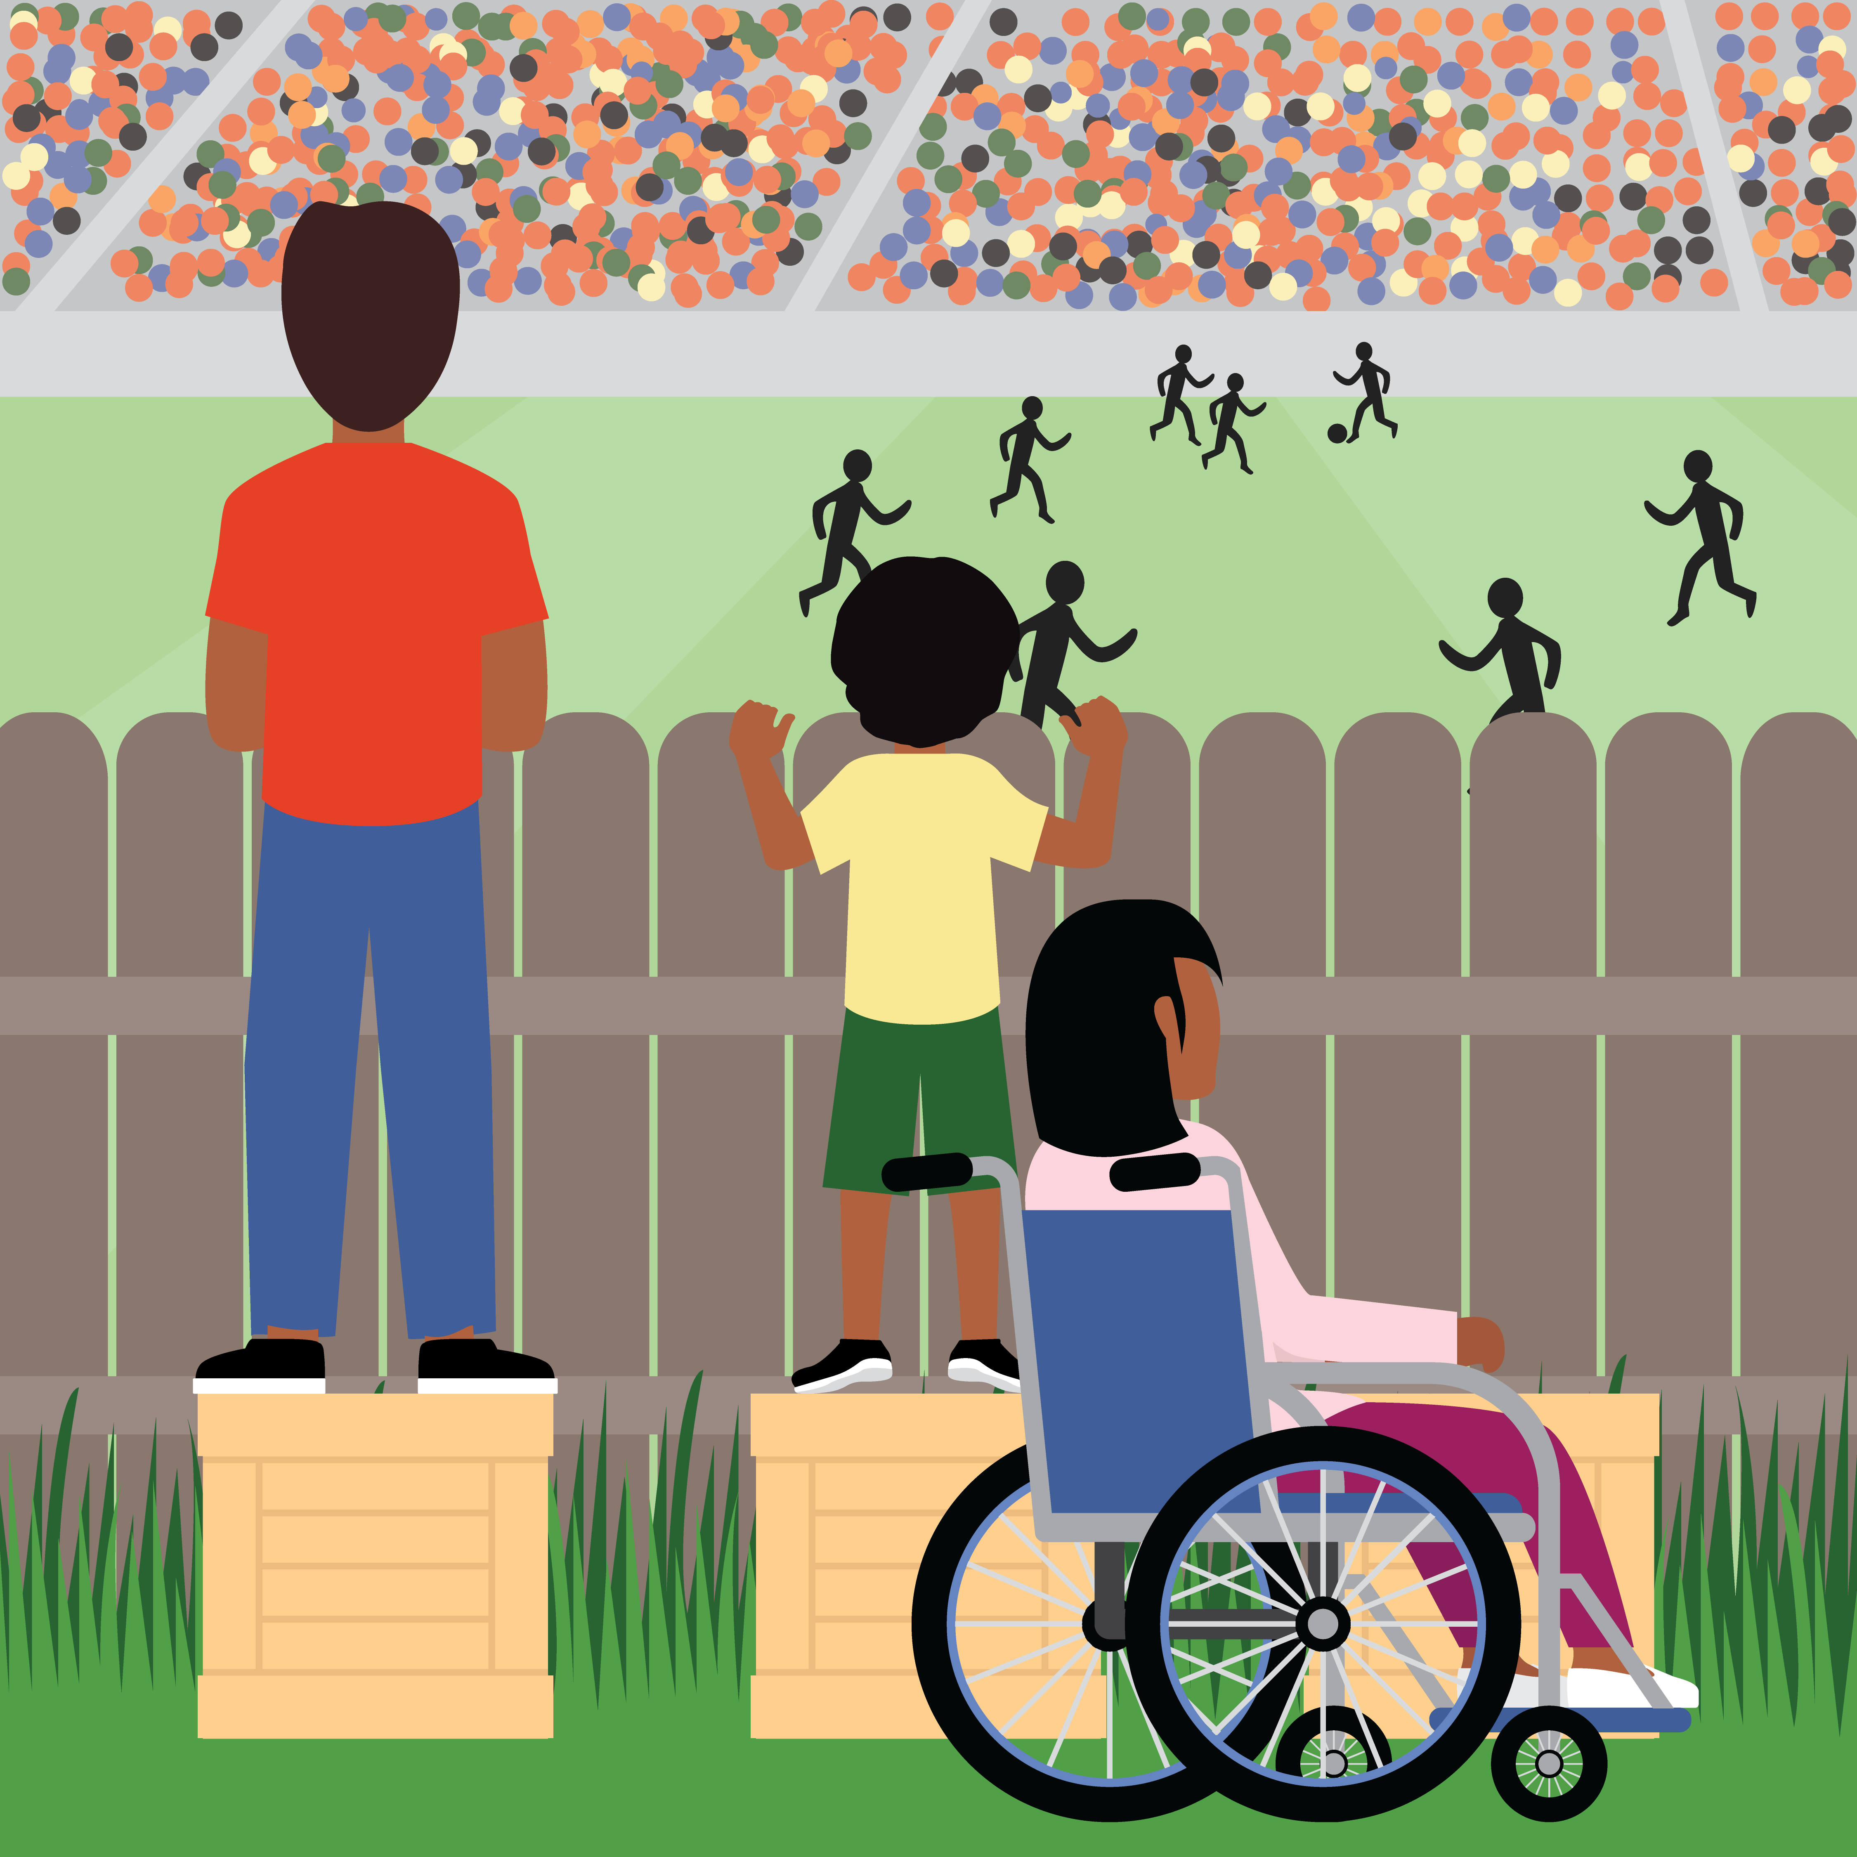
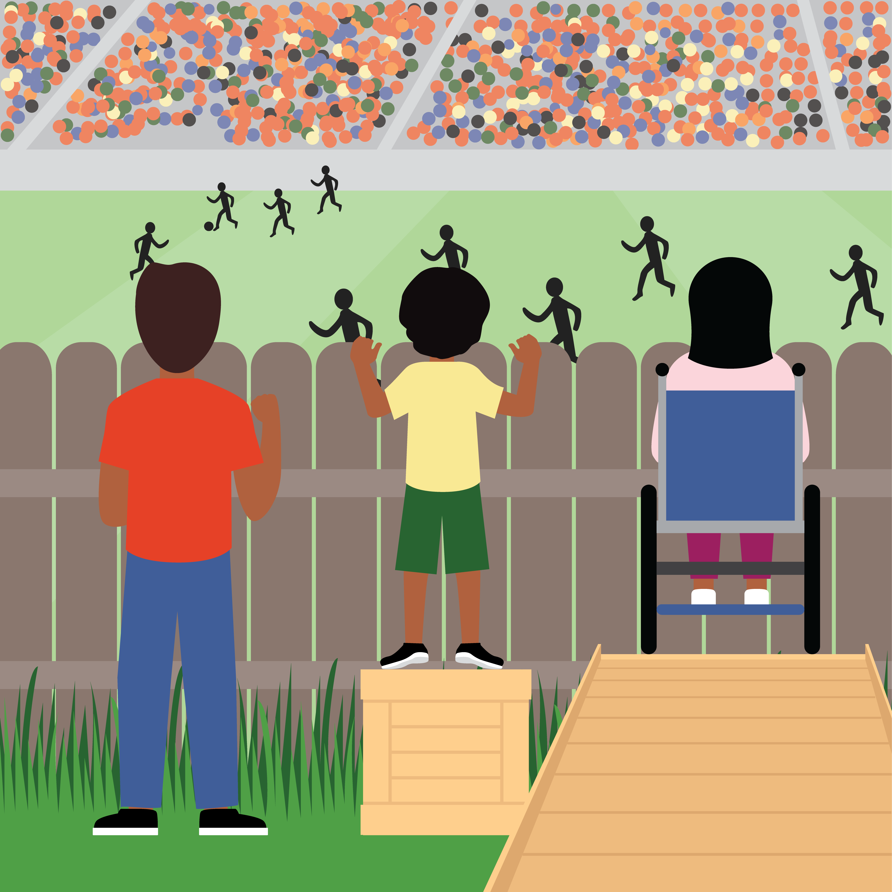
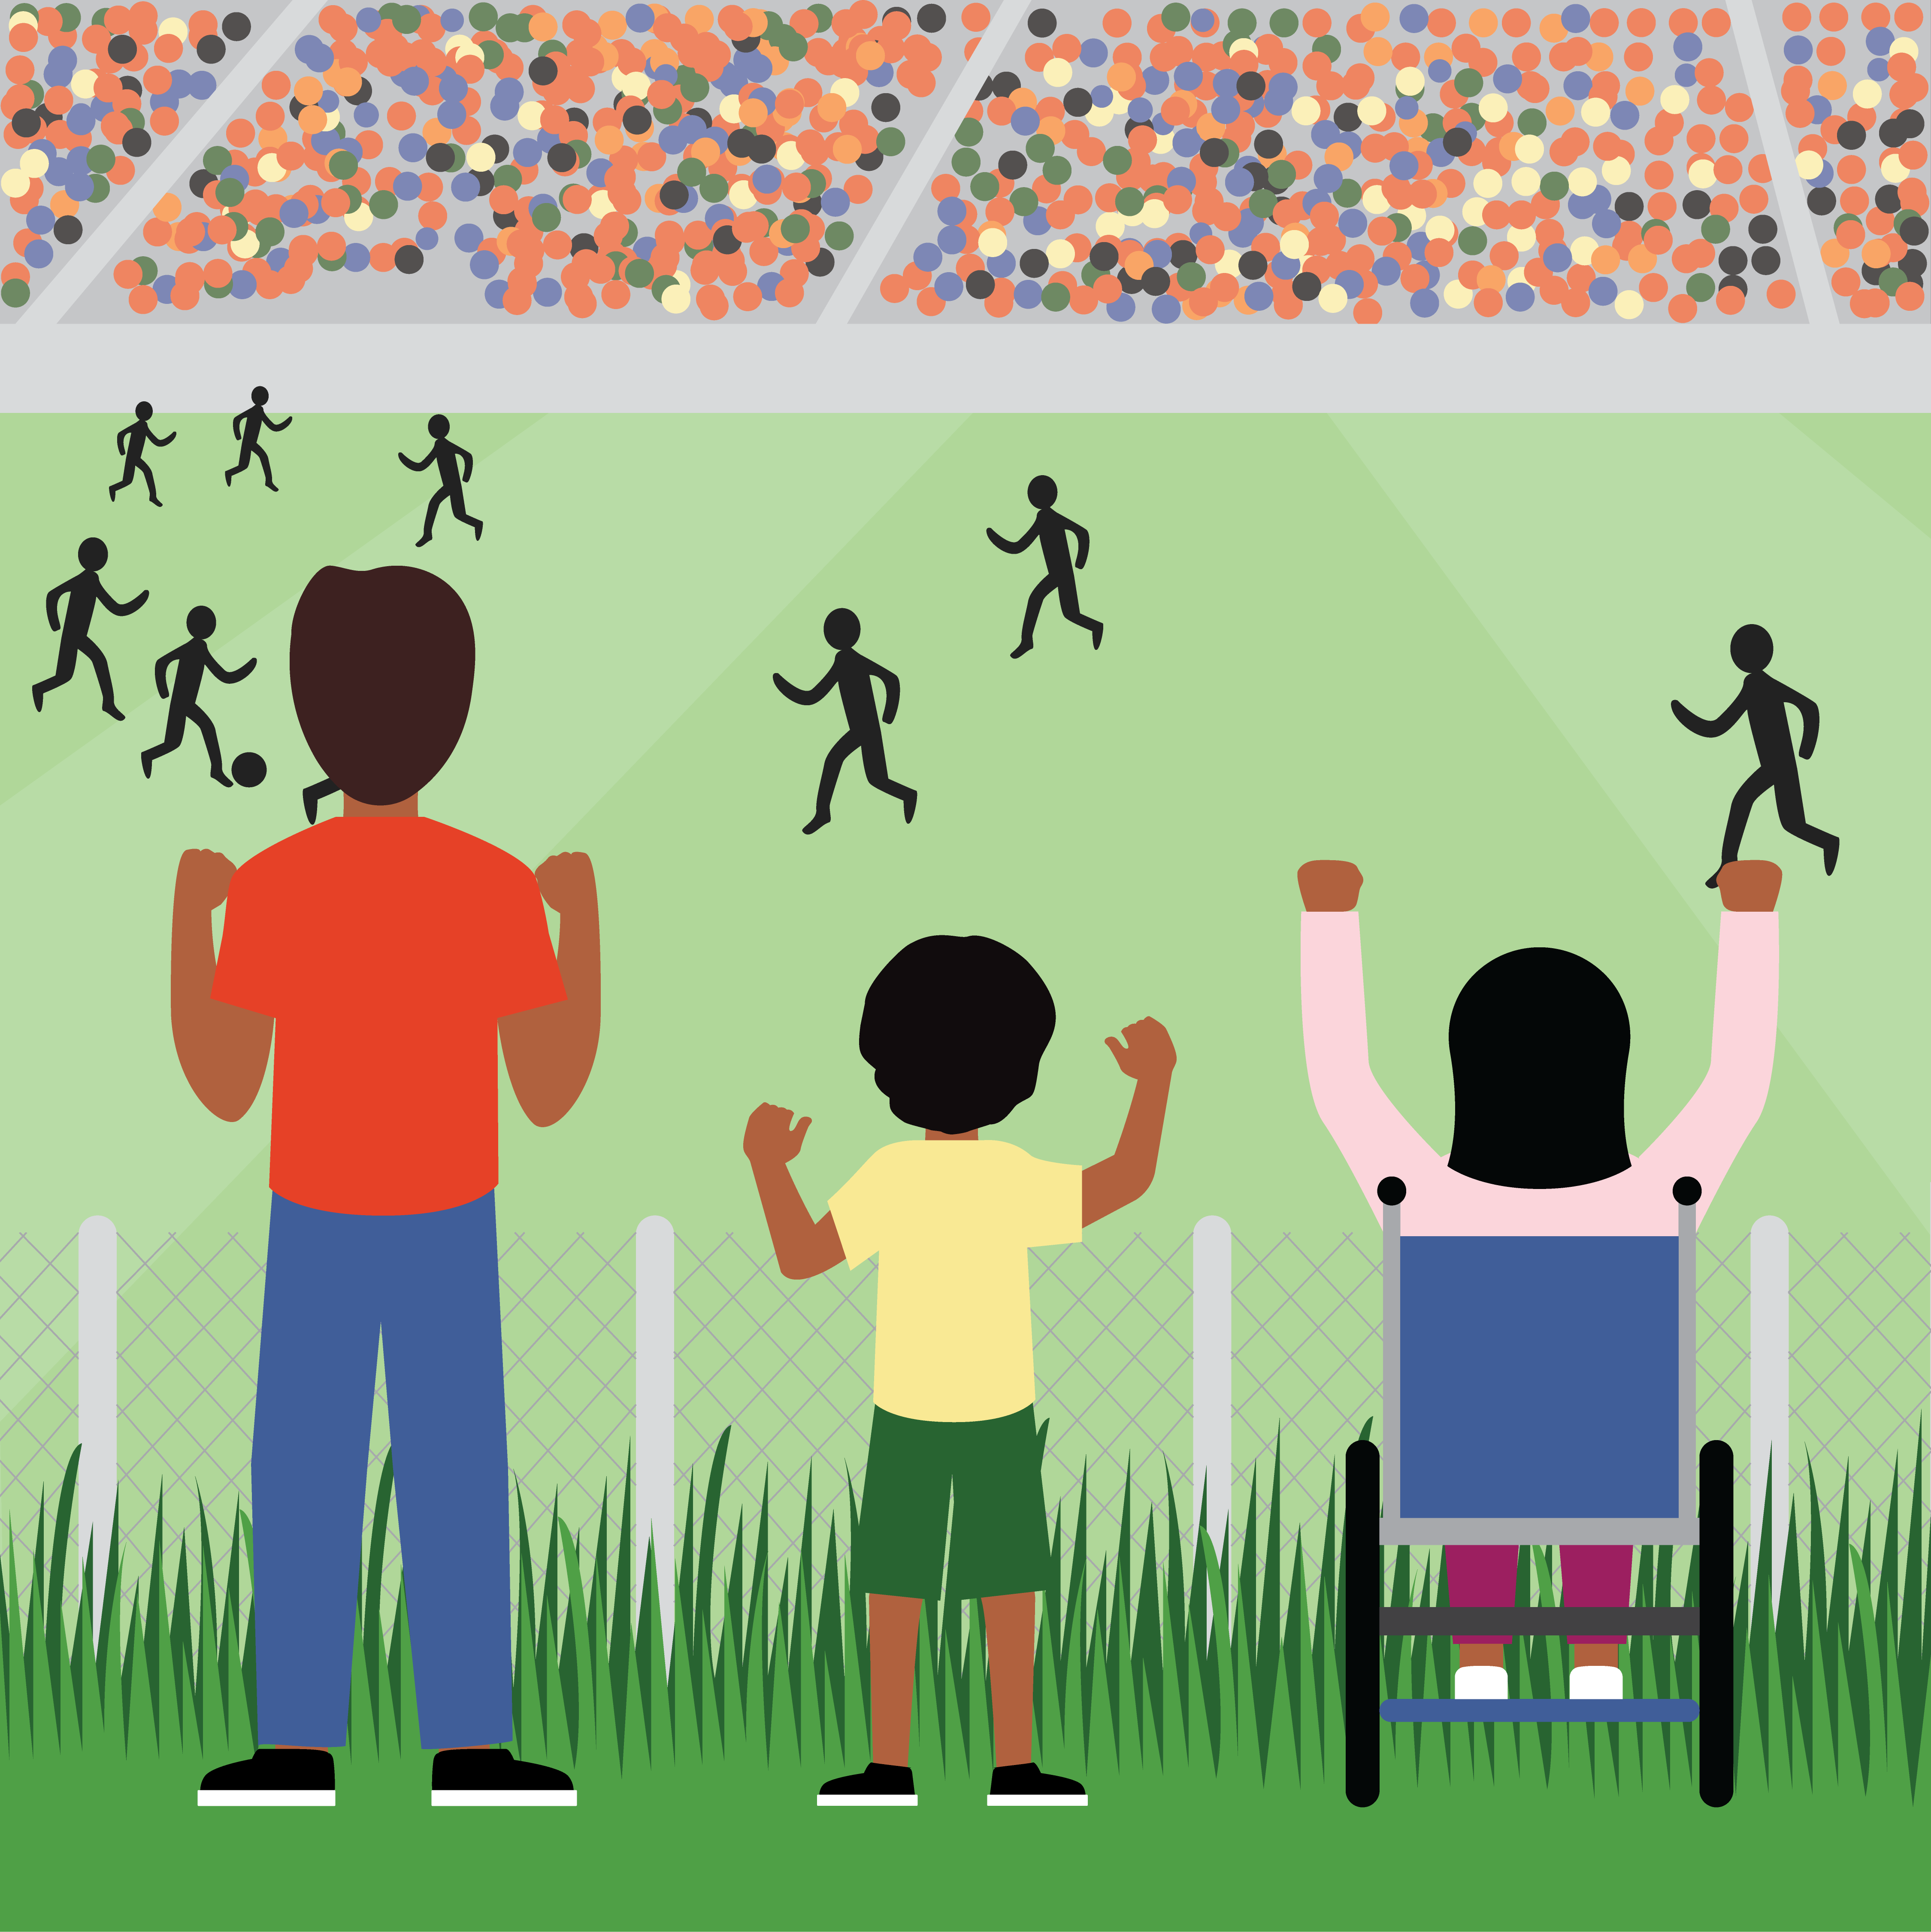
From Reality to Justice
Reality
Few get more than they need. Some get just what they need. Many get less than they need.
Equality
Everyone gets the same support; this works better for some than for others.
Equity
Everyone gets the support they need.
Justice
The structural and systemic cause of inequality is addressed. Everyone can come as they are.
7
Notes:
Diana
We have covered a lot of concepts today, all to help set a foundational and shared understanding of what it looks like to grow as an inclusive leader in your life and work.
As inclusive leaders our overarching goal is to move the spaces we are a part of from ‘Reality” to “Justice”. As you go through this training, consider where you have power to make these changes in big or small ways.
[Key Points]
Reality: Many people still don’t even have equal access to the supports (in this image boxes) they need.
Equality: In this image it is assumed that everyone will benefit from the same supports. They are being treated equally.
Equity: In this image individuals are given different supports to make it possible for them to have equal access to the game. They are being treated equitably.
Justice: In the final image, all three folks can see the game without any supports or accommodations because the cause of the inequity (the wooden fence) was addressed. Of course, if the systemic barrier was truly removed the three people shown in the forefront would not be watching the game outside the stadium fence, they’d be in the stands with the rest of the fans.
[Say]
Because Advantage and Disadvantage exist currently, we end up with an environment of inequality. This is represented by the “Reality” image.
As inclusive leaders our overarching goal is to move the spaces we are a part of from ‘Reality” to “Justice”. As you go through this training, consider where you have power to make these changes in big or small ways.
Reality: We often talk about Equity vs Equality. But it’s important to realize that the reality is many people still don’t even have equal access to the supports (in this image boxes) they need.
Equality: In this image it is assumed that everyone will benefit from the same supports. They are being treated equally. However, as you can see, the ‘same thing’ works better for some than for others. A crate is not helpful for the person in a wheelchair.
Equity: In this image individuals are given different supports to make it possible for them to have equal access to the game. They are being treated equitably. This means that people don’t get the same thing—and that’s okay.
Justice: In the final image, all three folks can see the game without any supports or accommodations because the cause of the inequity (the wooden fence) was addressed. The systemic barrier has been removed.
{Additional Questions for Discussion if Time}
What else do you notice?
How might this apply to your company? Your team? The way you chose to lead?
[CLICK]
{FACILITATOR NOTES}
The concepts of scarcity and abundance could be helpful here: often organizations are afraid of people “taking advantage” of offerings or policies that are meant to help especially those facing some sort of disadvantage. The fear of some getting “too much” is stopping them from ensuring that some get “enough”. (For more on how as a society we actually benefit from an abundance mindset read Malcolm Gladwell’s “Talking to Strangers”).
[RESOURCE]
Here’s a good website for more learning: https://www.diffen.com/difference/Equality-vs-Equity
The original of this meme was done by Craig Froehle back in 2012. To learn more about the look/purpose of his original illustration as well as how it has been iterated on and reused over the years, read his blog post. It may also give you some interesting discussion points on the nuance of the image, and the meaning behind various elements: https://medium.com/@CRA1G/the-evolution-of-an-accidental-meme-ddc4e139e0e4#.pqiclk8pl

Slide 8
Advantage Accumulates into Privilege
8
Notes:
Julien
[Main Idea]
In this graphic the mountain represents the accumulation of advantage, and the ditch represents the accumulation of disadvantage.
[Key Points]
Where a person experiences advantage across many identity points: Advantages accumulate into Privilege. Additionally, a vital part of Privilege is what does not happen to us, so we often do not see our Advantages clearly.
Every person has their own experience of both Advantage and Disadvantage
In our work, we’ve found that conversations around privilege, especially when they are with those who find themselves somewhere on this green mountain, can quickly become personalized, create an experience of shame/self-consciousness (”But I’ve worked hard to get what I have/where I’ve gotten to”) and lead to deflection. We’ve chosen to talk about privilege as the accumulation of advantage because 1) it’s less triggering (define trigger here) 2) we can talk about discrete advantages as opposed to just “privilege” in general and 3) it’s easier for just about anyone to acknowledge that they have some advantages.
What does positioning on the mountain get you access to? Obvious proximity to the top, so influence, potential, compensation etc. But also the view, what you can see on the horizon etc. and the value of the real estate in general.
[Say]
Finally, we want to recognize that various opportunities and experience across our lives are influenced by advantage and disadvantage. As inclusive leaders we want to make sure that opportunities are maximized for all, and that disadvantage is negated for all, and how both of these experiences are effected by more than just identity points.
In this graphic, the mountain represents the accumulation of advantage, and the ditch represents the accumulation of disadvantage.
Where a person experiences advantage across many identity points: Advantages accumulate into Privilege. Additionally, a vital part of Privilege is what does not happen to us, so we often do not see our Advantages clearly.
Disadvantage, in contrast, accumulates into, well more Disadvantage. We should expect strong feelings and conflict in the face of the constant inequities.
Most of us have both advantage and disadvantage operating in our lives, which slows how quickly our mountain grows, or how deep our ditch gets.
Some identity points – like gender, race, and economic standing carry a heavier weight in how Disadvantage and Advantage work in our lives and in history, than other identity points (like interests, hobbies, etc.
Working to create an inclusive culture that takes these realities into account requires that we seek to understand and navigate experiences of Disadvantage and Advantage, together. Blame and shame don’t help here.
Every person has their own experience of both Advantage and Disadvantage
{Facilitator Notes}
Mention Caste: The Origins of Our Discontent, by Isabel Wilkerson – a brilliant explanation of how Advantage organizes into Privilege, and Disadvantage into Marginality
[Transition]
We’ll see an illustration of how advantage and disadvantage play out in the next slide.
[Click]
[Resources]
Caste: The Origins of Our Discontents, by Isabel Wilkerson

Slide 9
Knowing your role to Drive Inclusion
Roles for Driving inclusion
Individual – Owning your story
Company
Leaders
Allies
9
Notes:
Julien to keep going to avoid back and forth

Slide 10
Individual
Owning your story
10
Notes:
Julien

Slide 11
Where are you on this journey when it comes to various aspects of identity? (e.g., gender, race, ability, sexuality, etc.?)
Notes:
Julien

Slide 12
“Many stories matter. Stories have been used to dispossess and to malign. But stories can also be used to empower, and to humanize. Stories can break the dignity of a people. But stories can also repair that broken dignity.”
― Chimamanda Ngozi Adichie

Slide 13
My own Journey
Identity
Hispanic Woman
Name
Diana
Identity
Parent
Colombia
/U.S
Engineer
Identity
Identity

Slide 14
My own Journey
Identity
White Man
Name
Julien
Identity
Parent
Third Culture
Veteran
Identity
Identity
Notes:
This is an identity exercise that we often do with clients around our skill, Own Your Story. I’ve been surprised by how different identity points have evolved over time. These are what are most important to me today, but that will likely change.
The two on the left are chosen, the two on the right are not. This distinction is important because we relate differently to chosen/innate aspects of identity.
Parent – I didn’t grow up thinking about being a parent but now that I am one, it’s become central to how I see myself.
Veteran – This is another chosen identity point, and perhaps the one I feel most conflicted and guarded about.
White man – I’m a cisgendered white man living in America. This comes with a lot of privilege and based on the fact that, as a nation/society, we’re finally coming to terms with what it means to have as racialized and gendered of a history, this means that I’ve got a lot of catching up and learning to do. This reality is made all the more acute based on the fact that I have three little white girls whose education I’m responsible for.
Third Culture – define this, feet/heart in two places. Practical example, the conscious decision to speak French with my children and what that means in terms of my own identity and what it means to belong, even in my own family’s context.

Slide 15
My own Journey
Engineer
Identity
Name
Brooksie
Identity
White Woman
Parent
Cisgender
Identity
Identity

Slide 16
Each of us is: like all others, like some others, and like no other.
― Murray and Kluckohn
Notes:
Brooksie

Slide 17
“Peers on immediate teams are THE GREATEST CONTRIBUTING FACTOR TO INCLUSION, followed by organizational leaders, department managers, and peers on other teams.”
Limeade Institute, 2019
Notes:
Brooksie

Slide 18
Company
18
Notes:
Brooksie

Slide 19
How to evolve from ‘check the box’ diversity efforts, to work that creates inclusive, equitable change?
Notes:
Brooksie

Slide 20
What can organizations do?
Create agency level goals for equity that align with mission and vision
Cascade those goals down to the department, project and individual levels
Notes:
Gwen

Slide 21
Accountability is key
Equity goals for performance
Those in supervisory roles are held accountable for implementing equitable best practices
Establish progress tracking towards goals
Notes:
Brooksie
Create accountability at individual and company levels
By developing equity goals for individuals and including them in annual performance evaluations equitable practices are operationalized within an organization
Incorporating equity into day-to-day work efforts becomes central to the work culture
Employees, especially those in supervisory roles, are held accountable for implementing equitable best practices and setting expectations for staff they do the same
Performance incentive payments and raises can be based on successful accomplishment of equity goals
Jacobs: senior leadership have compensation tied to inclusion and diversity goal/priority, must have 2 diverse mentors;
40-40-20
2020 distributed an Action Plan for Advancing Justice and Equality, dashboard created to track our progress towards those goals

Slide 22
Has your agency conducted an Equity Audit?
An Equity audit collects data outlining barriers that impede access to resources, and opportunities.
An equity audit is a leadership tool for data driven decision making.
An equity audit assesses hiring/promotion rates & blind spots, biases in organizational policy and practice and leadership.
Notes:
Gwen
An Equity audit collects data that informs the process of removing programmatic barriers that impede access to resources, and opportunities
By conducting an equity audit an organization will have a critical leadership tool to support data driven decision making
The audit will assess rates of hiring and promotions and identify blind spots and biases in organizational policies and practices and leadership.
Blind spots: review requisitions for gender neutral language and language that may deter working parents with gaps in employment from applying, are interview panels diverse?

Slide 23
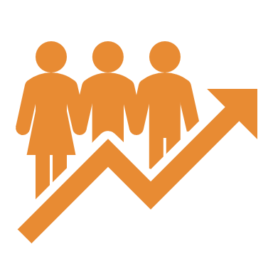
Has your agency done a pay equity study?
Pay Equity is at the heart of equitable practices.
Transparent pay grade structures with clear essential knowledge and experience.
Regularly check in with the marketplace.
An external pay audit can always be conducted.
Notes:
Brooksie
Pay Equity is at the heart of equitable practices. Organizations, to stay competitive, should pay competitive salaries (aligned with the current market) and establish internal pay equity.
Pay grade structures should be transparent with easily understood essential knowledge and experience to support payment.
Regular market salary data source study should be considered to keep competitive and attract top talent.
An external pay audit can always be conducted, focused racial and gender equity corrections can be focused to ensure the work is on the right track.
And now I’ll hand it off to Diana

Slide 24
Leaders
24
Notes:
Brooksie to transition to Diana

Slide 25
Good for people, good for business
Well-being
Experience
Engagement
Turnover
Reach
Employees who feel included have 19% greater well-being in their lives.
Employees who feel included are 51% more likely to recommend their organization as a great place to work.
Employees who feel included are 28% more engaged at work.
Employees who feel included intended to stay at their organization 3X longer.
Employees who feel that they receive adequate information within their organizations are 4X more likely to feel included.
Limeade Institute, 2019
Notes:
Diana

Slide 26
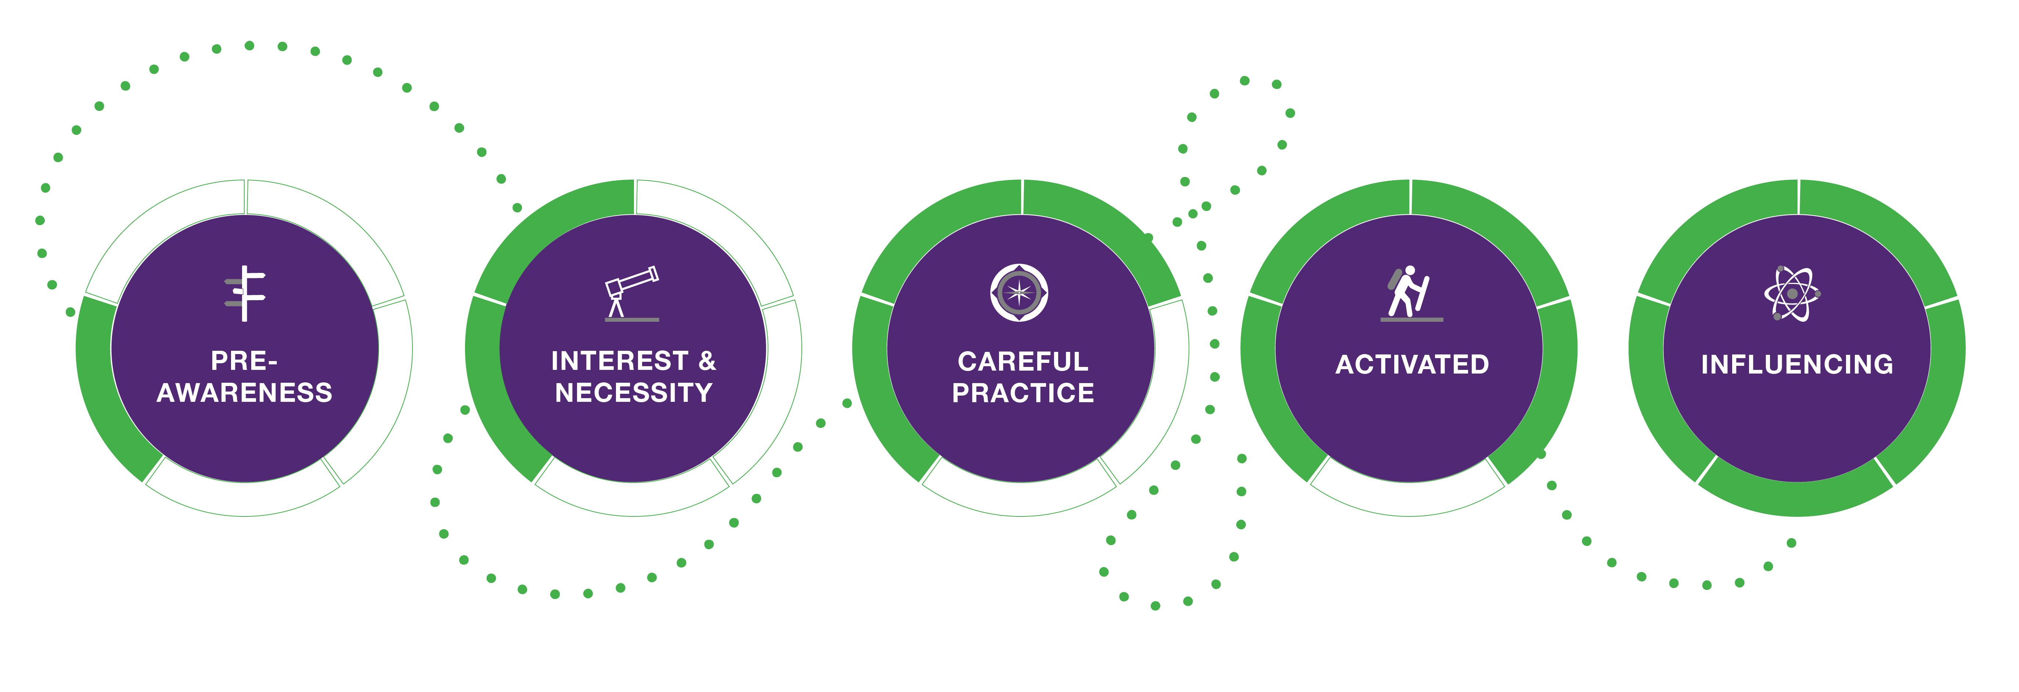
The 5 Stages of Transformation
“Why does this matter?”
“Will you tell me a little more?”
“How can I do this?”
“How do we do this together?”
“Where can I share my power and use my influence?”
Where are you on this journey when it comes to Transformation?
Notes:
Diana
Pre-Awareness: I am not yet aware of inclusion and diversity’s significance for my influence as a leader.
Interest & Necessity: I am motivated to learn and am beginning to see the value and need (both business case & to my personal brand) for inclusion as it relates to my colleagues and other stakeholders.
Careful Practice: I experiment cautiously, with a mix of awkwardness and confidence in my skills, humbly learning to contribute inclusively across the many aspects of identity.
Activated: I am hungry for change and growing in confidence with the way I engage with inclusion and diversity at work. I effectively recognize opportunities for greater inclusion, build belonging with my team and peers, and problem-solve with sensitivity to multiple aspects of identity.
Influencing: I am seen as a valuable resource in making our culture more inclusive. I am aware of my limits, and honor others’ experience by seeking their contribution and learning from them. I am seen as an accountable ally, a colleague with humility, and a leader with a clear point of view who is committed to systemic change.

Slide 27
Allies
27
Notes:
Lynne to transition to Julien

Slide 28
As an Ally, we seek to provide Safety & Standing to those on our teams, in our organizations, and for ourselves.
Psychological Safety
The feeling that it is safe to take risks, learn, and be vulnerable with others.
Psychological Standing
The belief that I belong in the conversation.
Notes:
Julien
[Main Idea]
Define Psychological Safety and Psychological Standing
[Key Points]
Psychological Safety is when we feel safe to take risks, learn, and be vulnerable with others.
Psychological Standing is our self-perceived legitimacy and confidence that we belong in the conversation.
[Say]
Two key elements that contribute to how we interact within various spaces are Psychological Safety and Psychological standing.
Google conducted Project Aristotle during which they researched the effectiveness of teams. They determined the greatest contributing factor to effectiveness wasn’t personnel makeup or resources was the psychological safety that was present on the team.
Psychological Safety is when we feel safe to take risks, learn, and be vulnerable with others.
Psychological Standing is our self-perceived legitimacy and confidence that we belong in the conversation.
Both of these effect the ways in which, and the extent to which, each person participates and contributes to a conversation.
One critical characteristic of an ally is that we don’t self-identify. Men are allies to women when women say we are. White folks are allies when people who aren’t white, say we are. Similarly, just because I perceive a space to be psychologically safe, doesn’t mean that all others believe it to be so. We have to have the courage to ask about this.
{Facilitators Notes: Some additional Examples}
Psychological Safety is the element that contributes to how many different perspectives that differ from the majority perspective are added to the conversation. Psychological safety affects brainstorming, creativity, innovation, and problem solving.
Psychological Standing is the element that contributes to people taking a part in certain groups or initiatives. Limited Psychological standing may prevent men from feeling like they should attend a workshop on Advancing Women in the Workplace—even though they are very much needed to make this happen.
[Transition]
Part of growing as an Ally in this work, is being able to recognize where Psychological Safety and Psychological Standing come into play, and to help reduce the barriers that are preventing people from feeling comfortable, wanted, heard, in various situations.

Slide 29
Common DEI Deflections
“I don’t see you as [a woman, Black, etc.], I was taught to treat everyone with respect”.
“Just tell me what to do.”
”It’s not in my place to speak up.”
“Identity, equity, etc., has no place in the workplace.”
“Everything is so PC these days”.
“White people are under attack.”
“We don’t have the [time/resources/expertise/money] etc. to deal with this.
“It’s definitely a Priority”
29
Notes:
Julien
[Main Idea]
Define Psychological Safety and Psychological Standing
[Key Points]
Psychological Safety is when we feel safe to take risks, learn, and be vulnerable with others.
Psychological Standing is our self-perceived legitimacy and confidence that we belong in the conversation.
[Say]
Two key elements that contribute to how we interact within various spaces are Psychological Safety and Psychological standing.
Google conducted Project Aristotle during which they researched the effectiveness of teams. They determined the greatest contributing factor to effectiveness wasn’t personnel makeup or resources was the psychological safety that was present on the team.
Psychological Safety is when we feel safe to take risks, learn, and be vulnerable with others.
Psychological Standing is our self-perceived legitimacy and confidence that we belong in the conversation.
Both of these effect the ways in which, and the extent to which, each person participates and contributes to a conversation.
One critical characteristic of an ally is that we don’t self-identify. Men are allies to women when women say we are. White folks are allies when people who aren’t white, say we are. Similarly, just because I perceive a space to be psychologically safe, doesn’t mean that all others believe it to be so. We have to have the courage to ask about this.
{Facilitators Notes: Some additional Examples}
Psychological Safety is the element that contributes to how many different perspectives that differ from the majority perspective are added to the conversation. Psychological safety affects brainstorming, creativity, innovation, and problem solving.
Psychological Standing is the element that contributes to people taking a part in certain groups or initiatives. Limited Psychological standing may prevent men from feeling like they should attend a workshop on Advancing Women in the Workplace—even though they are very much needed to make this happen.
[Transition]
Part of growing as an Ally in this work, is being able to recognize where Psychological Safety and Psychological Standing come into play, and to help reduce the barriers that are preventing people from feeling comfortable, wanted, heard, in various situations.

Slide 30
Question
Do you remember a time when you used a DEI deflection?
Notes:
Julien

Slide 31
What Men (and historically advantaged) Can Do
Don’t expect others to teach you; approach your learning with humility and curiosity
Don’t react, but reflect on what colleagues offer you
Take time to align on the intent and impact on your actions to people who differ from you
Engage your peers to join you in learning and sharing together
Learn about your own identity and what that means historically
Put yourself in positions where you are not a part of the ‘majority’
31
Notes:
Julien
Going into this work with humility, curiosity, and courage. We have a lot of catching up to do given the various systemic and historic advantages that have accrued to us.
Be open to feedback and differing experiences.
Be dogged in thinking about intent and impact. Clarify intent if helpful and believe someone when they tell you about the impact you’ve had.
Influence others to join you in the work. Encourage psychological standing.
Own Your Story and reflect on your own identity. What do your four core aspects of identity look like?
In 2014, the Public Religion Research Institute data showed that a full 75 percent of whites have "entirely white social networks without any minority presence.” How are you seeking opportunities to broaden

Slide 32
Own Your Story
Listen to Build Trust
Seek & Give Feedback Courageously
Respect Individuality & Build Belonging
Equip Your Colleagues to Progress
Create an Inclusive Culture
Inclusive
Behaviors
This is about personal initiative and agency. Answering the “tell me what to do” question for ourselves.

Slide 33
Key Takeaways
Inclusion is a sense of uniqueness & belonging
Inclusion is good for people, and good for business
Everyone plays a role in driving inclusion
In order to include others, we must understand power dynamics, and work on empowering others
This is a journey — understand your own stage and start from there!
Accountability is key to driving equity and inclusion
33
Notes:
Diana
What other takeaways

Slide 34
Q&A
34

Slide 35
Individuals
Company
Leaders
Allies
What can employees or individuals do?
What can employers do?
What can leaders do?
What can allies do?
35

Slide 36
Individuals
What can employees or individuals do?
What to do to recognize and/or create a safe environment that is diverse/inclusive?
How can individuals maintain a positive outlook towards inclusion, even when it doesn't seem to be happening?
What can individuals (non-management) do to promote inclusion in an office environment?
How can we encourage more inclusion for non-protected status people who might "fall under the radar"?

Slide 37
Company
What can employers do?
How to measure inclusion? Engagement surveys?
What are the touch points with different parts of the organization, beyond HR?
Should inclusion be addressed top down or bottom up?
How can employers provide transparency on implementation of initiatives?
How to operationalize Equity and Social Justice (ESJ) into strategic plans?
What could A&E industry do to help K-12 students understand barriers for entering industry and help remove them?
Has the trend for an open plan office environment/lay out helped promote inclusion?
What are some of the most effective changes to recruitment and hiring processes to be more inclusive?

Slide 38
Leaders
What can leaders do?
How to create an inclusive environment, that is not a one-size-fits-all?
How can you reframe the work to change the power differential equation and get a broader range of perspectives reflected in final decisions?
What can leaders and individuals do in meetings to address inclusion, given the different thinking process, personalities and power dynamics?
What are/will be some key metrics to indicate progress/ success?

Slide 39
Allies
What can allies do?
What guidance can you offer white men who seek to support gender equity and racial justice in the mobility realm?
What are a few professional behaviors that will add inclusive value to work in white male dominated office environments?
How to encourage allies to speak up when they witness microaggressions or someone saying something unacceptable?

Slide 40
Other
What ideas to improve equity do you have?

Slide 41
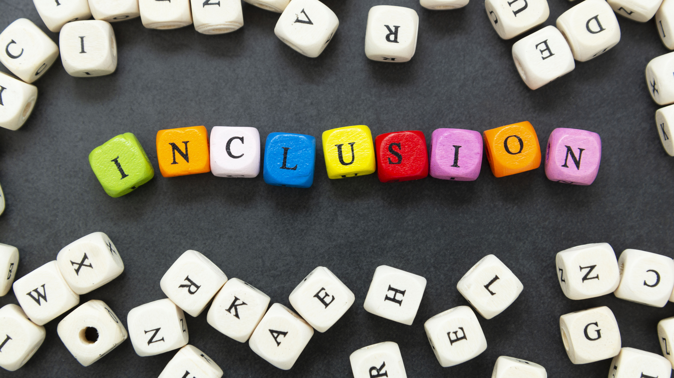
Thank you!

