Slide 1
New York State Bridge Authority Automated Incident Detection
Formed in 1932
Maintains & Operates 5 Bridges & Collects Tolls
1 sworn Police Officer
Lower tolls
Notes:
Formed in 1932 – NYSBA maintains and operates bridge crossings over the Hudson River for the economic & social benefit of the people of New York State.
5 Bridges – NYSBA maintains 5 bridges and related infrastructure in the Hudson Valley, collects tolls to provide long-term financial stability of the Authority, operates bridges with safety & mobility in mind, and provides accountability and transparency in operations.
1 Sworn Police officer who oversees safety & security
Lower tolls – Round trip toll on the Mid-Hudson Bridge in 2022 is $1.75, down from 1933 rates of $2.20.

Slide 2
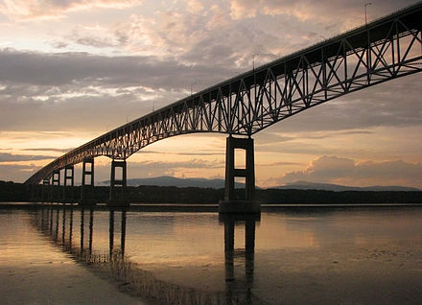
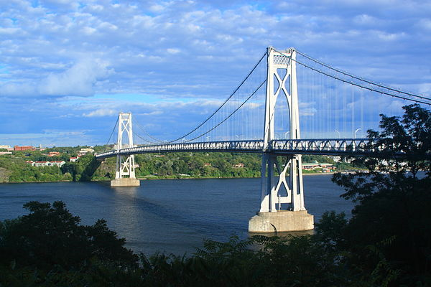
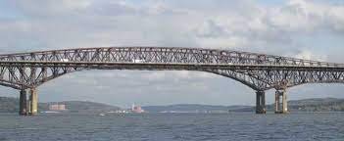
New York State Bridge Authority Jurisdiction
Rip Van Winkle Bridge
Kingston-Rhinecliff Bridge
Mid-Hudson Bridge
Newbaugh-Beacon Bridge
Bear Mountain Bridge
Notes:
2 Cantilever bridges, 2 suspension bridges, and 1 underdeck cantilever bridge

Slide 3
New York State Bridge Authority Operational Needs
Cameras for Monitoring & Incident Detection – NYSBA has existing cameras that operators use to manually monitor incidents across 5 bridges. The Authority needed an automated method to identify incidents without upgrading existing camera infrastructure.
Incident Identification & Response – With over 63M trips annually, the Authority needed a method to quickly identify incidents and mobilize emergency response to limit the impact on travelers, alert drivers to traffic incidents and safety hazards and improve emergency response times
Resources and Staffing – To maintain lowest operational costs at the best level of service, the NYSBA has limited staff to monitor multiple cameras on 5 bridges 24/7/365. The Authority’s goal was to improve operations and safety without adding the extra cost of additional operational staff.

Slide 4
Initial Citilog Automated Incident Detection Deployment - 2016
All 5 Bridges use existing cameras – NYSBA did not need to upgrade any camera infrastructure.
Central Server for Analytics – Central server to house data from all field devices and report analytics on all bridges. Authority had approx. 16 cameras per server in house.
Learning mode – System was able receive feedback from operators reviewing alerts and learn if circumstances such as ice or snow buildup falsely alerts as debris or stopped vehicle, utilizing Machine Learning mode.
Police Review – System alerts can go directly to the NYSBA police officer for review of incidents involving injury or fatality accidents or security events.

Slide 5
AI-based Incident Management
Wrong-way
driver
Debris on road
Slow vehicle
Pedestrian on road
Heavy congestion
Smoke in tunnel
Stopped vehicle
Sold only by in North America

Slide 6
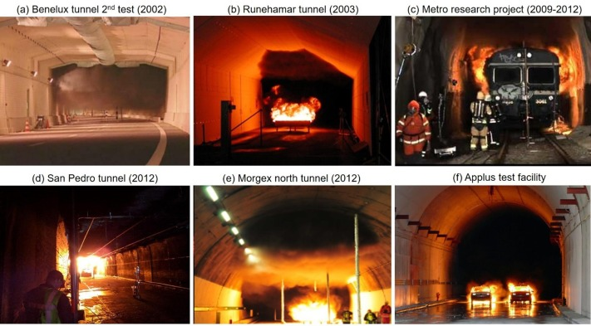
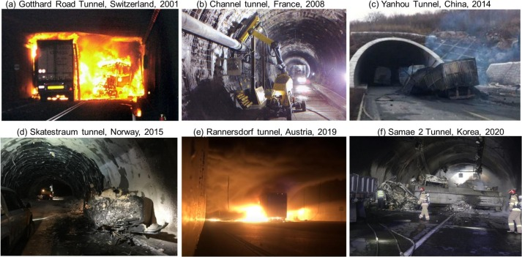
AI-based Incident Management
Citilog formed in 1997 to address a life-safety need in transportation – efficiently identifying serious "incidents" on roadways.
In March of 1999, the Mont Blanc tunnel fire caused 39 fatalities, and new safety laws were developed for the EU, including Automated Incident Detection, so Citilog's primary focus became AID for tunnels.
In May 1999, two months after the Mont Blanc accident, 12 people died in the Tauern Tunnel near Salzburg, Austria, after a truck plowed into the back of a car, setting off a chain of explosions.
January 2002 Gotthard Tunnel one of the world's longest road tunnels after two trucks crashed head-on Wednesday, trapping motorists. At least 10 people died, police said.

Slide 7
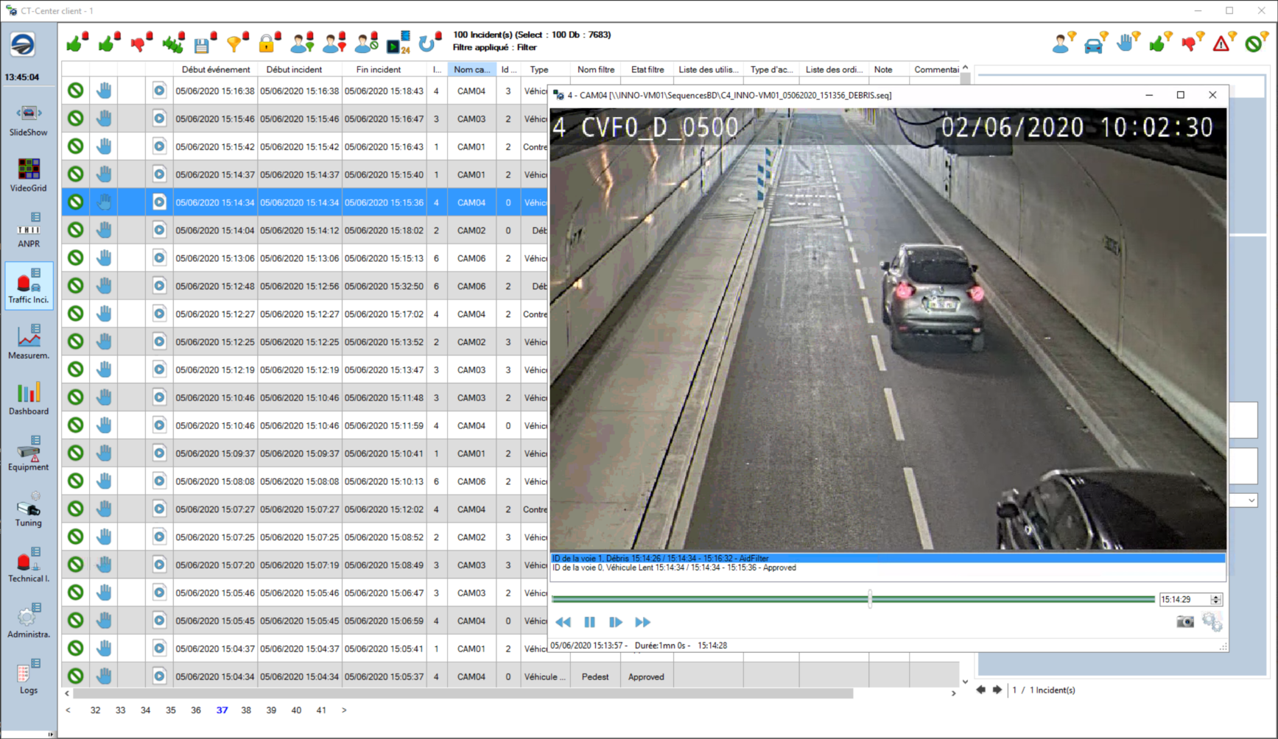
AI-based Incident Management
Using standard digital video feeds, this system provides automated detection of traffic ‘incidents’, sends real-time alerts to the Traffic Management Center operator, and triggers other user-defined actions (signage, law enforcement, etc.).
Environments:
Tunnels
Bridges
Highways
(Smart Shoulders,
Reversible HOV,
Toll Lanes)
Incident / Alert types:
Wrong-way vehicle
Stopped vehicle
Smoke / Fire
Debris / Small object
Pedestrian
Slow vehicle
Congestion

Slide 8
Benefits of AID Systems – safety, security, time, cost, environment
Roadway Operators (TMC)
Detect incidents sooner – 5-10 times faster – and without constant observation
Validate incidents reliably – 85-95% rate
Assess severity of incidents, including any “security threats”
Identify traffic problems that can be addressed by the agency (design, signs, etc)
Responders
Mobilize sooner and arrive sooner (less congestion built up the sooner they approach)
Quickly assess severity to determine the right response
Clear hazards more quickly/safely (secondary crashes increase exponentially with response time)
Travelers
Faster emergency response can save lives
Emergency response is prepared for the severity of the incident
Less likely to have secondary crashes that can increase injuries
Reduced congestion delays – improved travel time reliability (less time, less fuel, less pollution)

Slide 9
Incident Management AI – What is Deep Learning?
What is Deep Learning in video analytics?
Machine Learning (ML) – supervised, offline ‘training’ of video analytics software to recognize incidents so it can be uploaded to live systems periodically to improve the performance
Deep Learning (DL) – uses a neural-network-based ‘training’ process to expose the video analytics to larger amounts of actual data, resulting in much better recognition of objects, their movement, and just as importantly, “non-incidents”
Experience matters – Citilog has been focused on incident detection for over 24 years, working on more than 1400 systems in 50 countries.
Better accuracy – far fewer false positives than the competition: ~ 1 every 10 days with Deep Learning.
AI
ML
DL

Slide 10
Incident Management – Wrong-way driver

Slide 11
Incident Management – Stopped vehicles

Slide 12
Incident management – Pedestrian on Roadway
Close-up view Distant view

Slide 13
Incident management – Debris / Small object
Close-up view Distant view

Slide 14
Typical server-based architecture – 2016
IP Camera
ONVIF-S
IP Camera
ONVIF-S
IP Camera
ONVIF-S
Local Area Network
CT-SDK
(Optional)
ATMS
VMS
CT-Center
Optional redundancy
CT-IM Analytics
(20 to 30 channels per CPU)
CT-Center Client

Slide 15
Typical edge-based architecture - Today
CT-IM Analytics
CT-IM Analytics
CT-IM Analytics
Local Area Network
CT-SDK
(Optional)
ATMS
VMS
CT-Center
Optional redundancy
CT-Center Client

Slide 16
Recent Upgrades to NYSBA Citilog AID Deployment
Upgraded Axis cameras – Runs Citilog Edge analytics to limit single points of failure.
New Wrong Way Driver Detection Algorithms – More accurate WWD detection in cameras viewing roadways w/ adjacent lanes in opposite directions.
Advanced Deep Learning – Citilog ADL reduces false alarms up to 90% for environmental factors such as snow, ice, rain, etc.
Banner Alert Classification – Stopped vehicles are now identified in the Center Alarm banner by vehicle type, such as truck, van, motorcycle, car, etc.
Security Improvements – Encrypted communications between Center & Edge devices allows for single port in firewall instead of multiple ports open for cameras.
Notes:
Upgraded Cameras - 120 all new Axis P 1375 replacing older cameras will have Citilog Edge analytics running in the cameras replacing the current server based analytics . This will provide fewer single points of failure. If one cameras goes down it will not affect detection on any other cameras. Where previously if a Server based analytics server went down 16 cameras would be out of incident detection service.
New Wrong Way Algorithms - Citilog’s newly developed Wrong Way driver detection algorithms will be deployed. One of the advantages is more accurate Wrong Way detections in cameras that are viewing roadways with adjacent lanes bi directional of each other.
Advanced Deep Learning - The upgraded system will also be using Citilog ADL (Advanced Deep Learning ) which will have the impact of reducing false alarms up to 90% previously caused by environmental factors such snow, ice , rain.
Banner Alerts – Stopped vehicles will now be identified in the CT-Center alarm banner by type of vehicle such as car, van, truck, motorcycle.

Slide 17
Some of the use cases in the U.S.
NYSBA – Bridges
PANYNJ, MTABT Manhattan – Tunnels
MassDOT, Boston – Tunnels
VDOT, I66 – Smart Shoulder
MTA, VDOT, HOT I95/I495 – Managed lanes
Baltimore, MD – Tunnels & Bridges
Port of Miami, FL – Tunnel
Presidio Tunnel, CA – Tunnel

Slide 18
Thank you!
Katherine Mertz
Sensys Networks, Inc.
(510) 326-9796 mobile
kmertz@sensysnetworks.com

