Slide 1
Improving Work Zone & Traffic Notifications through New Technology & Digital Standards
ITS Washington annual Meeting
Tacoma, Washington
December 14, 2022
Justin Belk, PE
Olympic Region Traffic Operations Engineer
Washington State DOT

Slide 2
Overview
Introduction
  Big Picture/Scope/Goals
  Common Terminology
  Background
WZDx Demonstration Grant
  WZDx-Compliant Feed
  Device/Schema Integration
  3rd-Party Platform
  Partner Agency Activities
Other WSDOT Smart Work Zone Practices
Planned/Future Opportunities
Notes:
A couple demonstrations of our work zone data will take place mid-presentation during the Device/Schema Integration and 3rd-Party Platform portions
These demonstrations will build on one another
We’ll also log into our WZDB during the background info to actually show its features rather than just screenshots

Slide 3
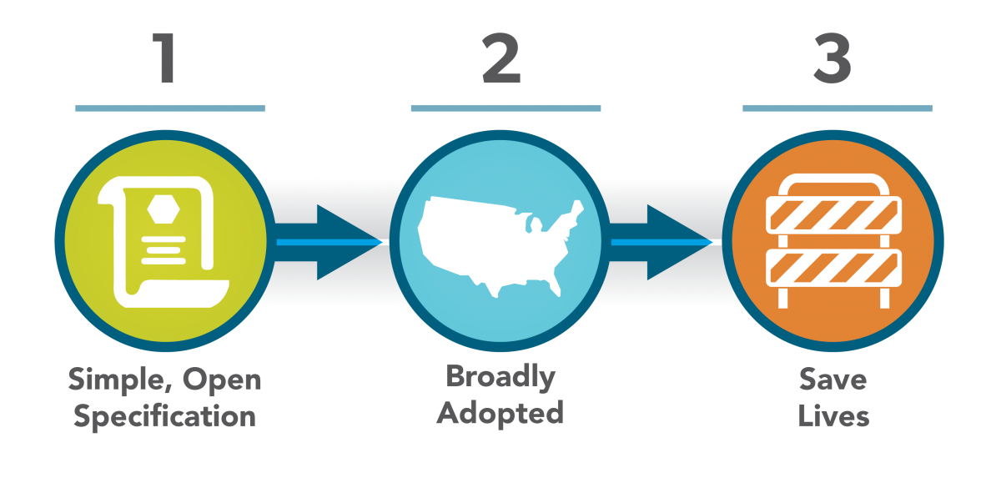
Big Picture
USDOT’s perspective:
Mimic the success of others
  General Transit Feed Specification started from the desire to communicate transit system schedules in a common way no matter the location
Standard data for work zones is a priority for automated driving systems
Funding (WZDx Demonstration grants) is a good way to provide the needed impetus
Public’s perspective:
Travelers rely on navigation apps, typically sourcing a mixture of public private data
Nonrecurring lane closures and detours is a significant cause of travel frustration
WSDOT’s perspective:
Accurately communicate and disseminate work zone information for everyone’s benefit
Notes:
Brief overview of the big picture and what we are trying to achieve from a number of perspectives. Each of these will be expanded on a little in the “Background” section after the next slide where we step back and define some terms.

Slide 4
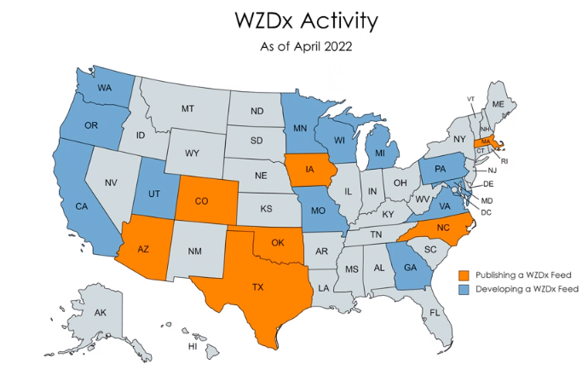
Background – National Efforts
WZDI:
US Department of Transportation and Federal Highway Administration establish need
WZDx:
Notice of Funding Opportunity
released June 2020
Goals:
Publish new feeds
Expand area
Increase fields
  provided
Automate/improve
  process & quality
Notes:
• Publication of a new WZDx-compliant data feed (Category A)
• Increased jurisdiction/system coverage of an existing WZDx-compliant data feed (Category B)
• Addition of optional field(s) to an existing WZDx-compliant data feed (Category C)
• The IOO and/or the entities performing work on their roadways do not produce one or more data elements in the specification, do not produce them at a sufficient level of quality or granularity, and/or do not produce work zone data on all roadways within or across local jurisdictions; (Challenge Area 1)
• The IOO’s data generation and acquisition processes (e.g., permitting systems, lane closure management systems) do not exist or rely on manual steps which delay data publication and/or reduce data quality; (Challenge Area 2)
• The IOO’s backend data system architecture makes it difficult and/or expensive to share data in different formats for different uses, both within and across an organization. (Challenge Area 3)

Slide 5

Background – Safety Case
Safety:
Work zones are designed for safety, but they represent one of the riskiest roadway scenarios when normal conditions are, by necessity, replaced with temporary and continually changing conditions.
All the typical factors in roadway crashes can be present in addition to highly vulnerable maintenance, construction, & utility workers and support staff.
Solution: WSDOT’s Work Zone Database (WZDB)
Provide for planning and coordination of work zone impacts
Accurately communicate and disseminate work zone information for everyone’s benefit
Future: CAT/ADS technologies and Smarter Work Zone strategies
Notes:
The is the WSDOT-centric ideology, the following slides expand on safety, our need for and development of better in-house processes, and more on the national scene.

Slide 6
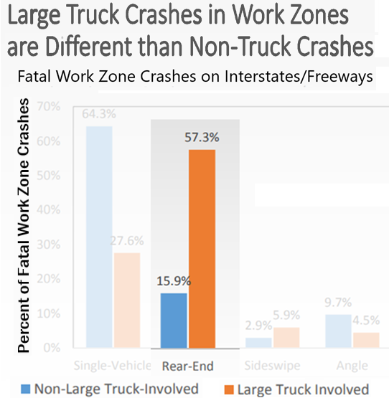
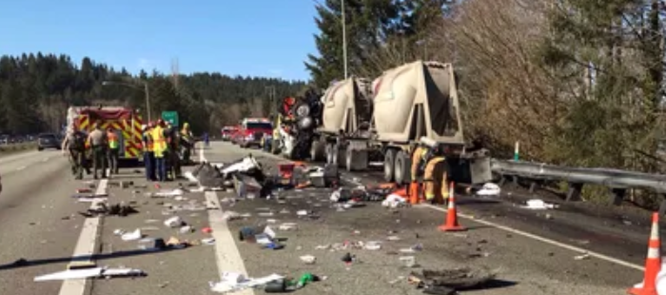
Background – Safety Case
National Work Zone Crash Statistics (2019):
84% of fatalities occur to road users
  16% to workers
90% of fatal crashes occur on freeways & 45+MPH highways
35% of fatalities involve large trucks
16% of fatalities occur to pedestrians/bicyclists
Washington-specific over the same time period:
7 fatalities occurred to road users
  3 involved large trucks
  0 workers, 0 pedestrians
Goal: Let’s do what we can to make it better
Work zones need to have visibility and advance notice
Notes:
These statistics communicate the need for state DOTs to take the lead on getting work zone information more accessible and visible

Slide 7
Background – NextGen WZDB
Statewide application and deployment
Original WZDB developed in one region – grew to be recognized as essential statewide
2017 – Multiple major project impacts around the state
Growing interest from multiple WSDOT regions with an identified need to communicate better between jurisdictions
Recognition that internal boundaries don’t resonate with drivers – OneDOT
NextGen WZDB Milestones:
NextGen WZDB re-development to SQL database backend capable of being
shared and used across other platforms - Late 2017
Basic forms and reports complete July 2019
Initial Implementation in Fall 2019
Dynamic Mapping/Visualization tool available Spring 2020
Future: Integration with commercial permitting and other public-facing systems
Notes:
Following up with screenshots of the mapping and other features in the WZDB – just in case we cannot actually log into and show it

Slide 8
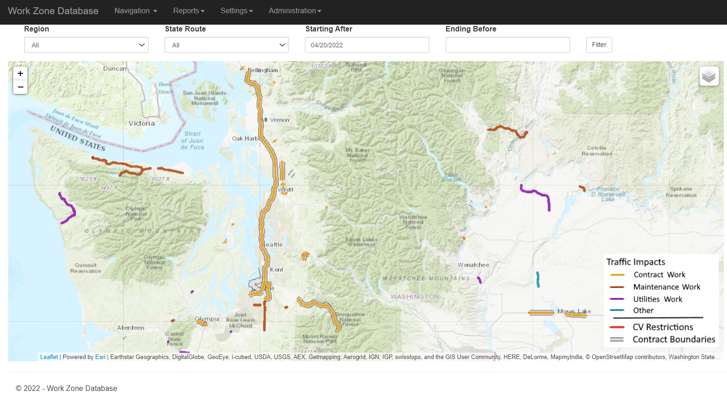
Background – NextGen WZDB
Statewide application and deployment
Original WZDB developed in one region – grew to be recognized as essential statewide
2017 – Multiple major project impacts around the state
Growing interest from multiple WSDOT regions with an identified need to communicate better between jurisdictions
Recognition that internal boundaries don’t resonate with drivers – OneDOT
NextGen WZDB Milestones:
NextGen WZDB re-development to SQL database backend capable of being
shared and used across other platforms - Late 2017
Basic forms and reports complete July 2019
Dynamic Mapping/Visualization tool available Spring 2020
Future: Integration with commercial permitting and other public-facing systems
Notes:
Mapping work zone data – demo NextGen WZDB

Slide 9
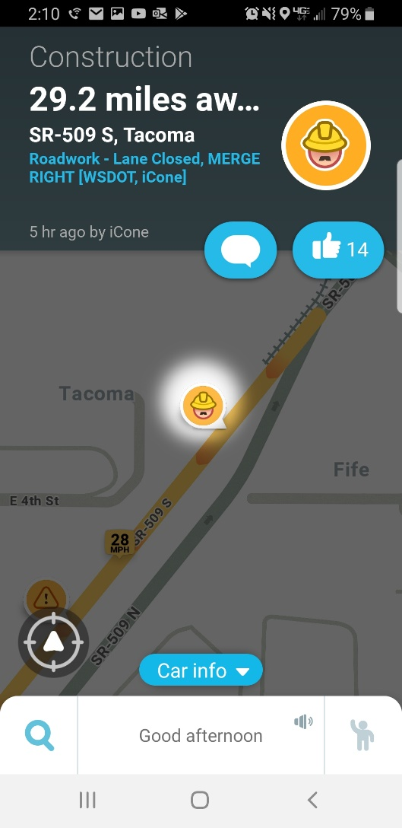
Background – Device pilots
iCone pilot project
Equip dedicated work zone crews in Olympic and SW Region with a few connected arrow board and iPin devices
MAP Team was being reported as police in Waze
Pros
WSDOT was able to inject our label into the Waze notification by working with iCone
  Increased the authority of the event in a crowd-sourced environment
  Anecdotally increased move-over/slow-down behavior
Cons
Limited data dissemination/usage
iPin may not fit the cones you have
Notes:
Try to summarize some feedback from our early/initial efforts

Slide 10
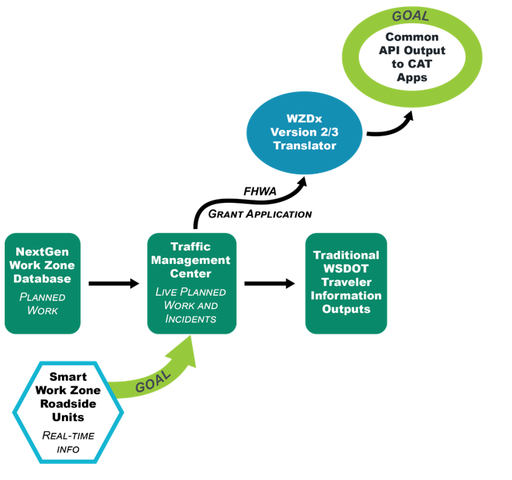
Background – Adapting Work Zone Best Practices for WSDOT
Build on existing WSDOT applications and workflow:
  Build automated connectivity into the system so that existing and future data sources can ingest the planning level information into real-time use (and eventually historical data collected)
Use existing off-the-shelf products: Test and integrate devices through low-risk pilot projects with available technology
Learn and develop specifications: Take existing lessons learned and institutionalize proven products and practices into daily activities and promote widespread use and adoption of smarter work zone technologies

Slide 11
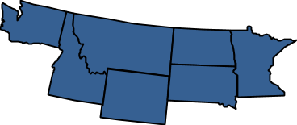
Work Zone Data Exchange Demonstration Grant
Scope
Publish WZDx-compliant feed (Project Category A & Challenge Area 1)
Expand pilot project to facilitate real-time confirmation of work zone events (Challenge Area 2)
  $25,000 for new devices to equip IRT trucks
  Use existing smart work zone products
  Other connections?
Collaborate with NWP private partners for testing WZDx-compliant feed
  Trihydro push out WZDx/TIM
Collaborate with NWP member states
  Conversion of ND GeoJSON feed
Notes:
Explain why we chose to approach the grant activity like we did

Slide 12
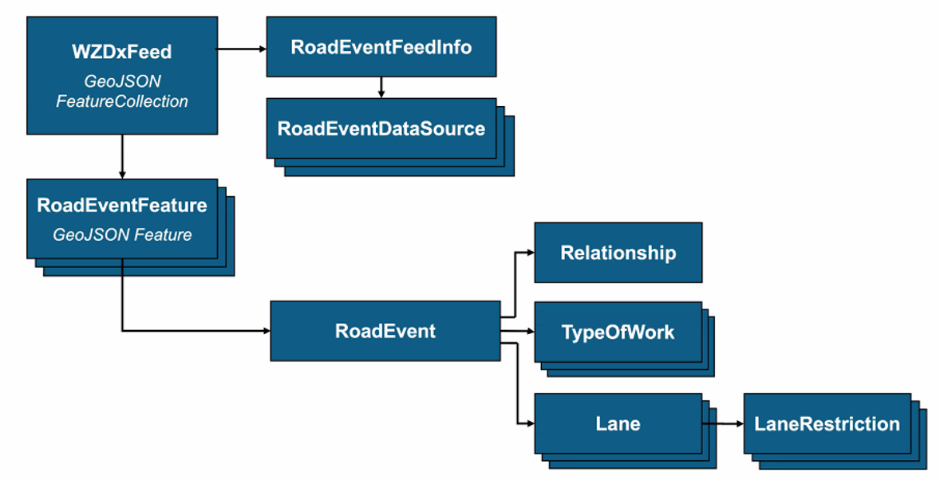
WZDx Demonstration Grant – Publishing Compliant Feed
Task 1
Publish WZDx-compliant feed

Slide 13
WZDx–Compliant Feed Development
What is the WZDx standard?
The Work Zone Data Exchange (WZDx) Specification enables infrastructure owners and operators (IOOs) to make harmonized work zone data available for third party use. The intent is to make travel on public roads safer and more efficient through ubiquitous access to data on work zone activity. Specifically, the project aims to get data on work zones into vehicles to help automated driving systems (ADS) and human drivers navigate more safely.
Improving access to work zone data is one of the top needs identified through the US Department of Transportation (USDOT) Data for Automated Vehicle Integration (DAVI) effort.
WZDx defines the structure and content of multiple distinct data feeds.
Each feed is distributed as a single GeoJSON file with the defined WZDx schema which makes it easy to map and consume.

Slide 14

WZDx–Compliant Feed Development
Notes:
Define GeoJSON

Slide 15
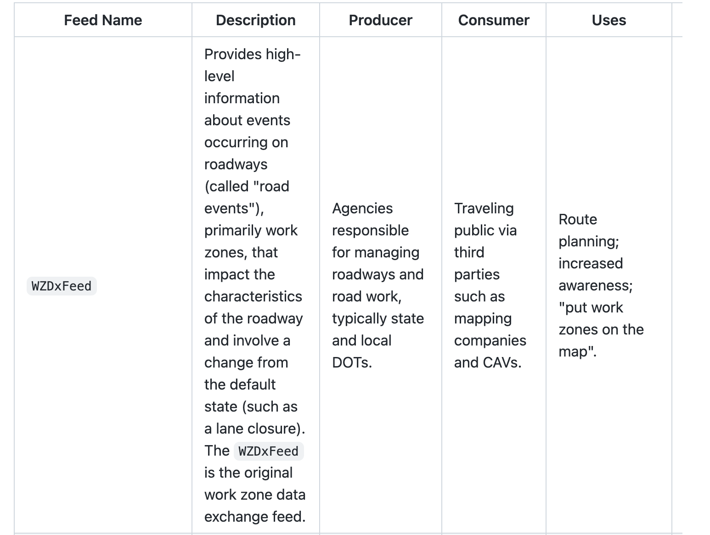
WZDx–Compliant Feed Development
Notes:
The WZDxFeed will be renamed in WZDx 4.1 to WorkZoneFeed to better describe what it is and align it’s name with other feeds. This change will also fix some confusion in the fact that prior to WDZx version 4.0 the only feed was WZDxFeed.

Slide 16
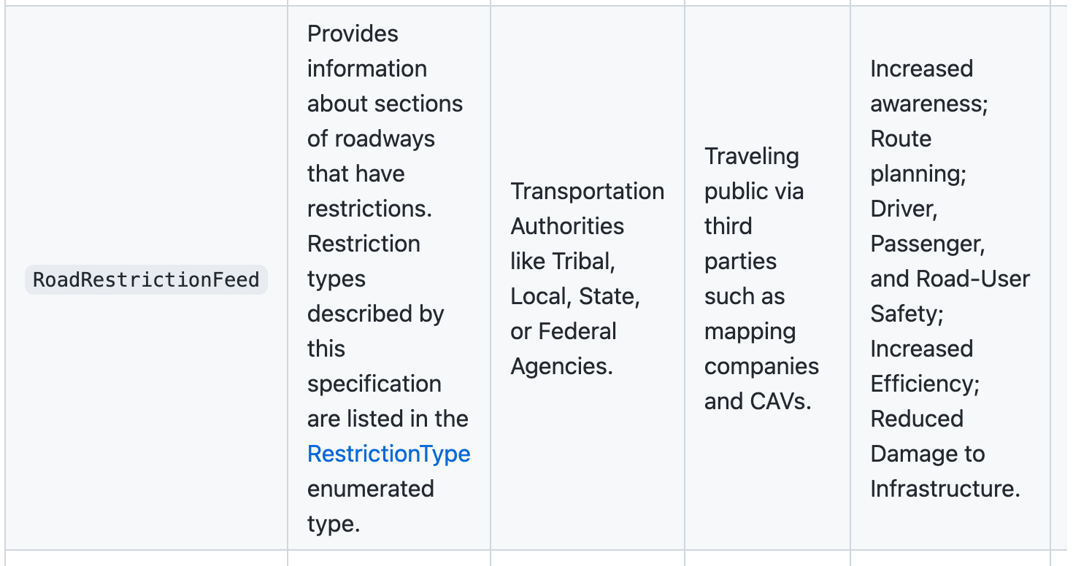
WZDx–Compliant Feed Development

Slide 17
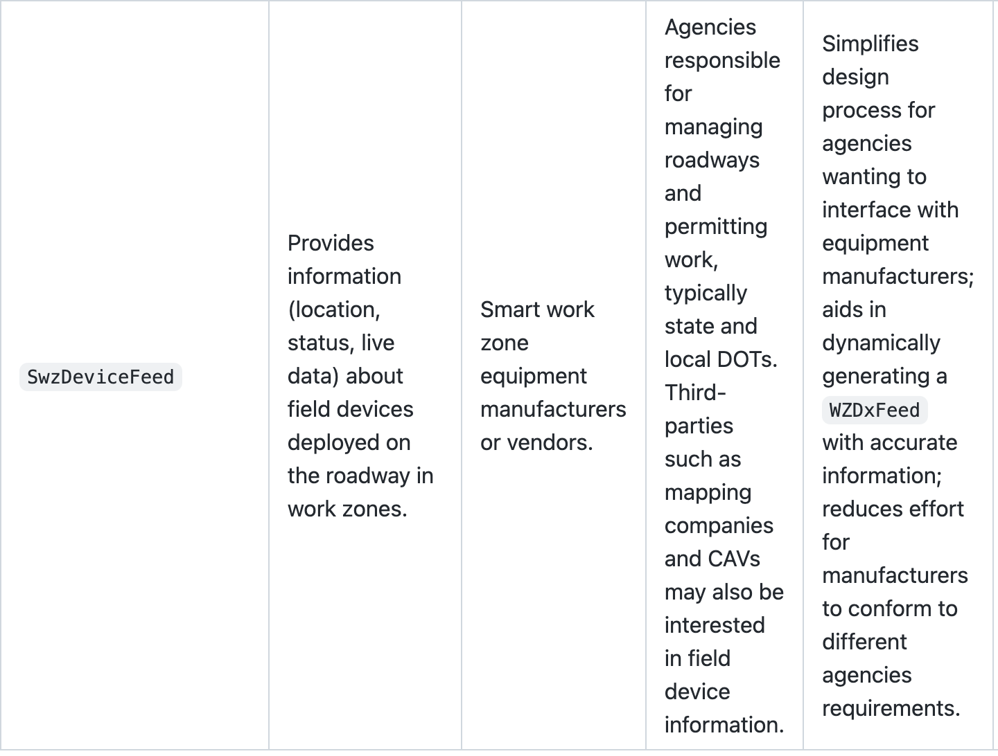
WZDx–Compliant Feed Development
Notes:
While this graphic mentions that a producer of this feed could be a smart work zone equipment manufacturer or or vendor, we use it rebroadcast information from our vendors. Some use current Wzdx feeds, most do not.
Currently support devices such as ArrowBoards, Cameras, Dynamic Message Signs, Flashing Beacons, Hybrid Signs, Location Markers, Traffic Sensors
The ArrowBoard object describes an electronic, connected arrow board which can display an arrow pattern to direct traffic. Arrow boards are often placed at the beginning of a lane closure—thus knowing the location of an arrow board can assist in programmatically generating a WZDx road event with verified spatial information.
The Camera object describes a camera device deployed in the field, capable of capturing still images.
The DynamicMessageSign object describes a dynamic message sign (DMS)—also known as changeable message sign (CMS) or variable message sign (VMS)—which is an electronic traffic sign deployed on the roadway used to provide information to travelers.
The FlashingBeacon object describes a flashing beacon light of any form (e.g. trailer-mounted, vehicle), used to indicate something and capture driver attention.
The LocationMarker object describes any GPS-enabled ITS device that is placed at a point on a roadway to dynamically know the location of something (often the beginning or end of a work zone).
The HybridSign object describes a hybrid sign that contains static text (e.g. on an aluminum sign) along with a single electronic message display, used to provide information to travelers. This object is intended to be general to represent hybrid signs with multiple functions, such as variable speed limit signs (VSLS), hybrid travel time signs, and other similar systems.
The TrafficSensor object describes a traffic sensor deployed on a roadway which captures traffic metrics (e.g. speed, volume, occupancy) over a collection interval.

Slide 18
Source 1 At Launch: WZDB

Slide 19
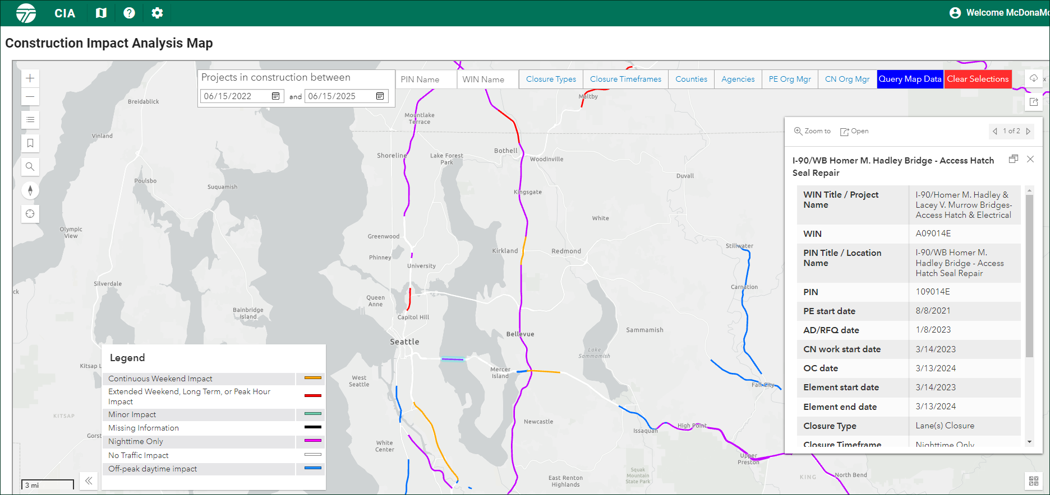
Source 2 At Launch: CIA (Construction Impact Analysis)

Slide 20
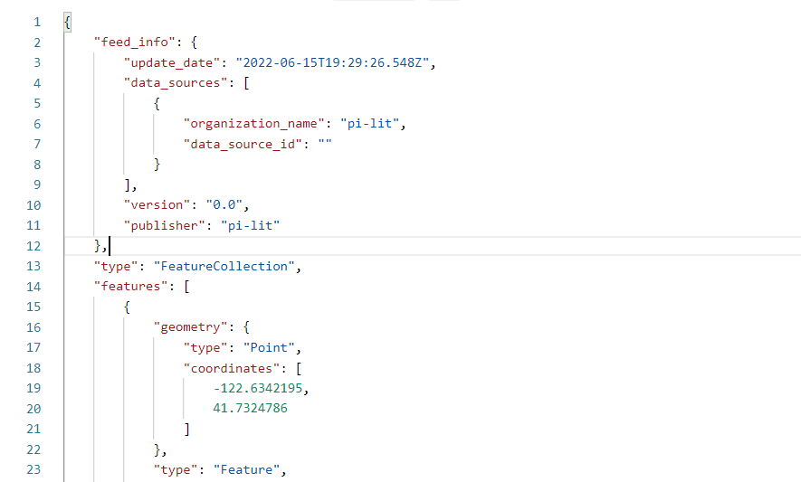
Source 3: Pi-lit Devices

Slide 21
WZDx–Compliant Feed Development
Challenges related to…
Lane labeling
Push vs Pull, Staging vs Runtime (how to store source data and get data into the feed)
Geospatial/linear referencing system (mileposts, ahead/back, lat/long)
Other development realities (programming language limitations)
Data Storage (document vs relational)
Notes:
WZDx standard for lane labeling is lane 1 – x from right to left, but that may not always match directly with how your agency or data provider identifies their lanes so some translation is required.
Push vs Pull, Staging vs Runtime (how to get data into the feed): Should data pull from the sources and go right out to the feed, or should there be ETLs written to transfer data.
With the possibility of having a lot of outside sources (internal data sources and device vendors) we decided to consolidate and normalize that data into a single database, which then feeds the WZDx feed.
Geo-spatial/LRS:
Mileposts in the feed are just single numbers. However, as roads are re-aligned through construction effort mileposts have a way of getting out of sync with the LRS. There is no concept of ahead/back indicators or similar designations to show a spatially correct milepost.
lat/long – agency or data provider may store the points in other spatial references so projection could be required. We store all spatial information in a state plan reference system which requires projection to WGS84 lat/longs.
WZDX 4.0 standard pushes to dynamic data structures which can be more challenging to adopt in a more static language like C# which we use at WSDOT. Other languages like JavaScript handle dynamic structures better. But we were able to adapt our parser and validator to work, but it did add time to the project.
Data Storage (document vs relational): One of the major reasons 4.0 moved to dynamic is so that the feed could be stored more easily in a relational format or a database.
Previous versions of the standard pushed more towards storing the output directly as a single file.

Slide 22
WZDx Demonstration Grant – Device/Schema Integration
Task 2
Expand pilot project to facilitate real-time confirmation of work zone events
  Procure new devices to equip IRT trucks
  Use existing smart work zone products
  Other connections?

Slide 23
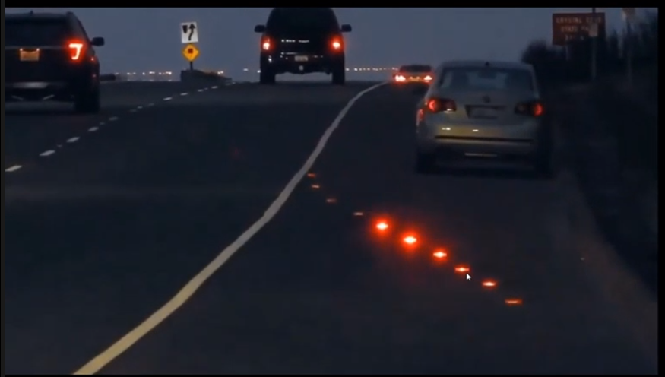
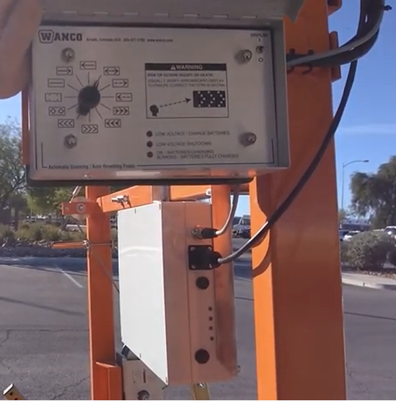
WZDx Device/Schema Integration and Development
Challenges related to…
Devices
Data (available and methods for pulling differ)
Confirmation of live status of real time events
Collaboration with…
iCone
Pi-Lit
Haas Alert

Slide 24
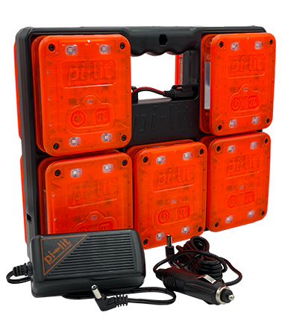
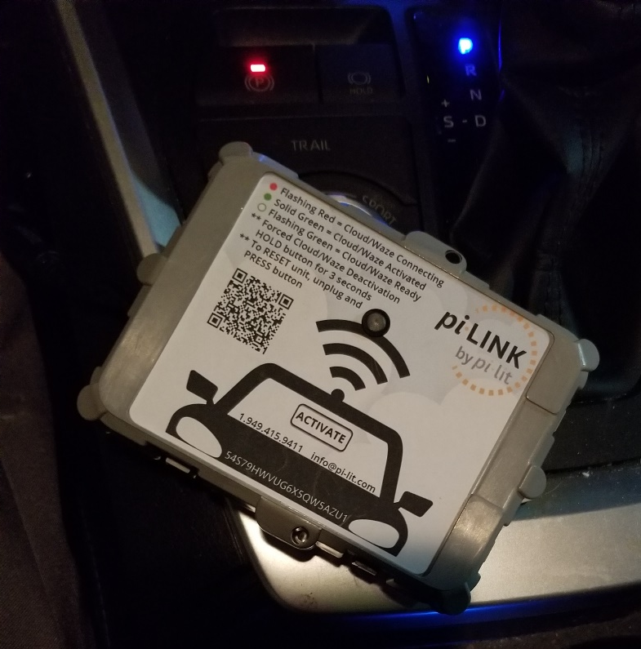

WZDx Device Details – pi-lit and pi-LINK
Use cases considered
Incident response teams
Responder-2-Vehicle connections
Notes:
100+ activations over 3 months over 16 devices. Activations average about an hour but range from less than a minute to a full day.

Slide 25
Pi-Link Vehicle/Flare to Cloud Technology
Pi-Link
Pi-Lit Sequential Flares
Gateway to transmit Pi-Lit device GPS location via cellular modem to cloud
12-V DC / 110-240 V regulator options
Deactivates if it travels ¼-mile away from activation point
Gravity controlled light output with tilt sensor automatically directs light output to optimize driver awareness
4 flash patterns with automatic synchronization
20 hour run time with Li-ion battery
Attach each magnetically to structure, place under cones to illuminate, or lay flat on ground

Slide 26
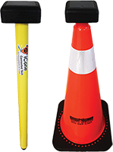
WZDx Device Details – iPin and Connected Arrow board kits
Use cases considered
Construction crews
WSDOT MAP teams (surveying/mapping)
Incident response

Slide 27
iCONE ConnectedTech
iPin
Arrow Board Kit
Transmits GPS location and ‘ON’ status of the device indicating “end of work zone” or other work zone features such as boundaries of where vulnerable workers are present.
Solar/battery powered
Dimensions: 26 in long, 1.5 in diameter
Material: Polycarbonate (PET-G)
Transmits GPS location and ‘ON’ status of the Board
Once activated, status of your arrow board is posted to XML within 2 minutes
Upon deactivation, status posted to XML within 60 seconds
Transmits Arrow Panel status every 15 minutes
Re-transmits location and status if the Arrow Panel moves more than 300 ft

Slide 28
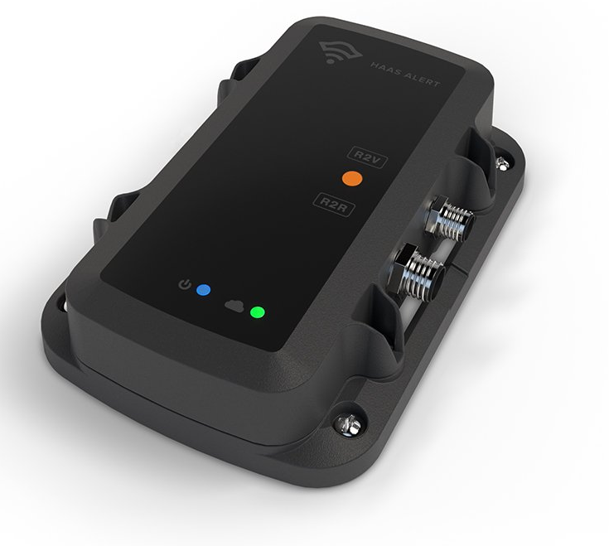
WZDx Device Details – HAAS Alert HA-5
HA-5 – use case – fleet solutions / MAP teams
Connects any flashing emergency lights
Cellular 3G or 4G LTE, GPS, real-time Safety Cloud™ connectivity
Mounts securely on the dash inside the cab of the vehicle or apparatus
Performs best with clear sky visibility
Dimensions: 5.4” x 2.7” x 1.3”
Input Voltage – Power: 12.5V – 15V
Input Voltage - Flashing Lights Main Wire (E-Master): 12V – 15V
Amperage: 120 mA peak draw
Operating Temperature: -40℃ to 85℃
Weight (Ounces): 7 oz.

Slide 29
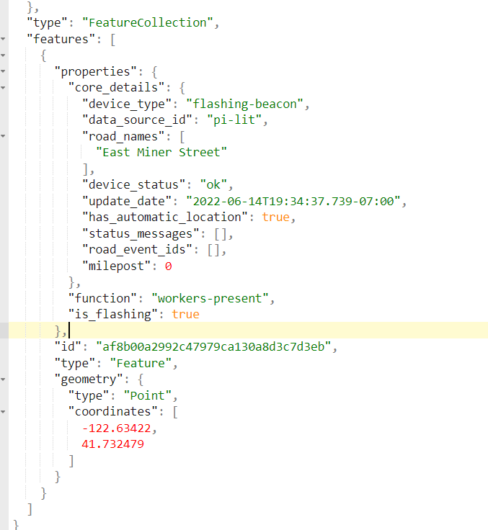
Notes:
Field Device after activation in feed – Show if can’t show live.

Slide 30
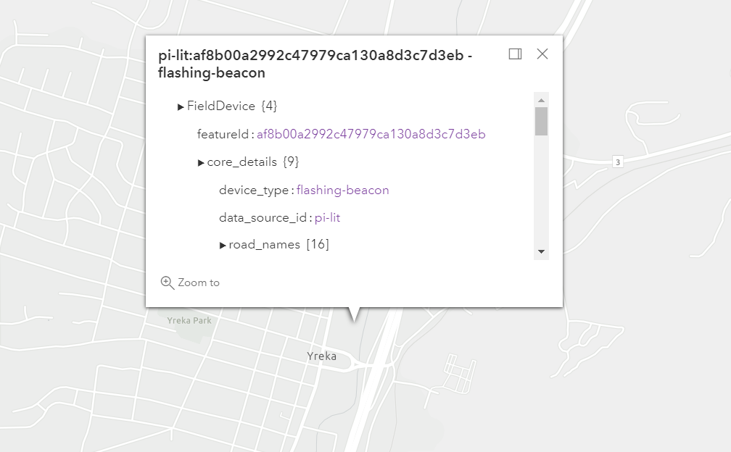
Notes:
Field Device after activation on map – Show if can’t show live.

Slide 31
WZDx Demonstration Grant – Device/Schema Integration
Challenges
API Access:
Vendor API access varies in types, cost and coverage.
Would love for more vendors to adopt WZDx.
Real-TIme Data.
WSDOT plan at launch is to refresh data every minute, but we would like to move to an event driven architecture where are notified about changes so we can react and populate our feed quicker.
Notes:
Every vendor has a different method for pulling their data. Challenges with converting those sources into the WZDx (where the data should go, etc)
”Real-time” data feeds
Everyone wants to get to real-time data, but there are challenges there, related to pulling or pushing and the time it takes to process.

Slide 32
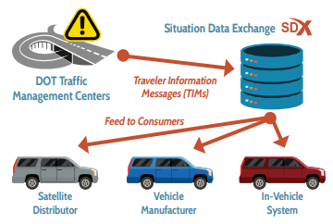
WZDx Demonstration Grant – 3rd Party Platform
Task 3
Collaborate with NWP private partners for testing WZDx-compliant feed
  Trihydro push out WZDx/TIM

Slide 33
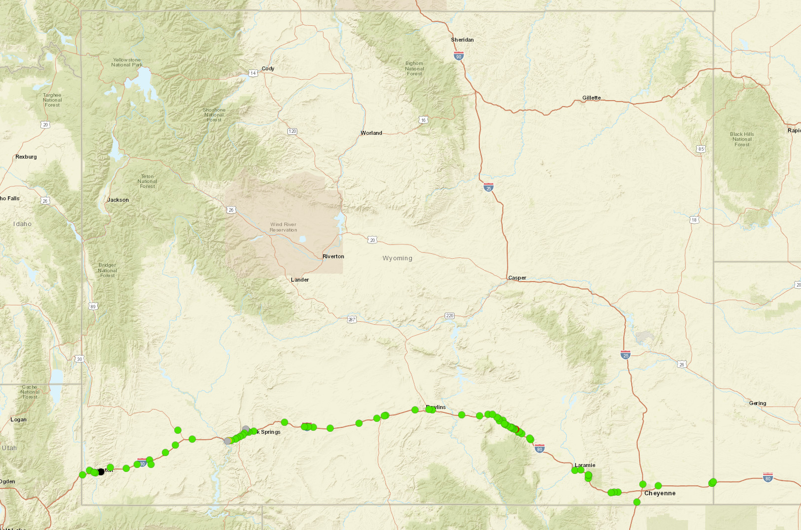
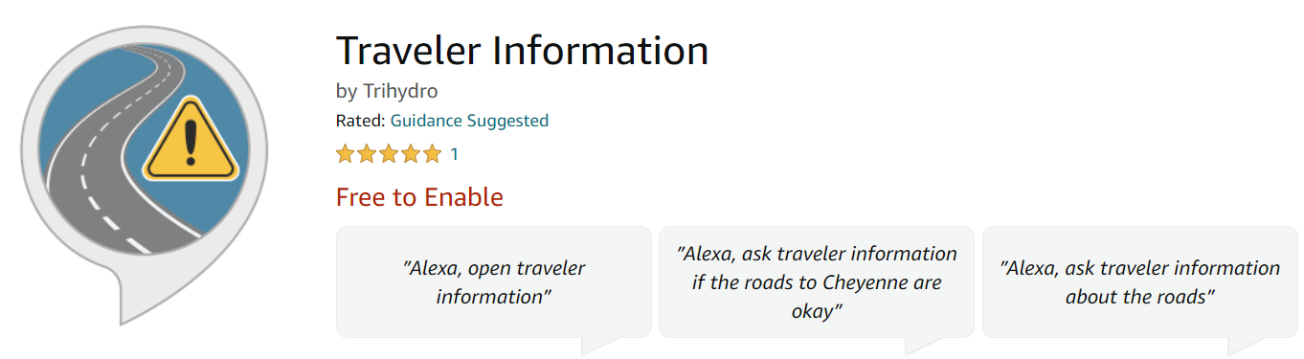
WZDx 3rd Party Platform Collaboration – Trihydro
What is the SDX?
Wyoming CV Pilot Project
Potential for expanded use
Challenges related to…
In/uptake
Data/translation
Security and other adoption considerations
Collaboration with Trihydro, WZDx, Alexa Skills
Notes:
The Situation Data Exchange (SDX) is a one-stop shop for critical, authenticated traveler information – a centralized data retention and distribution source for connected and autonomous vehicle (CAV) information such as Traveler Information Messages (TIMs). Originally developed under funding from the United State Department of Transportation (USDOT) for its Connected Vehicle Pilot Program, Trihydro took over system ownership in early 2019.
Trihydro - has created a way to consume WZDx feeds

Slide 34
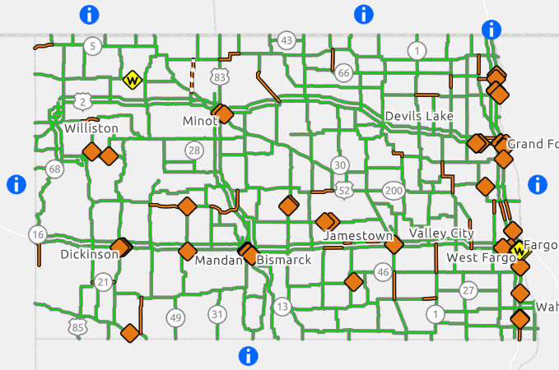
WZDx Demonstration Grant – Partner Agency Activities
Task 4
Collaborate with NWP member states
  Conversion of ND GeoJSON feed

Slide 35
WZDx Partner Agency Activities
Why is developing solution for ND a good fit?
ND systems overview
Potential for expanded use
Challenges related to…
Interoperability among states
Overlapping agencies
Ownership/governance questions
Collaboration with…
North Dakota
City of Seattle and other local agencies
You?
Opportunities moving forward
Any agency or group that develops solutions in .NET can make use of our efforts for their own feed thereby increasing WZDx adoption and widespread success

Slide 36
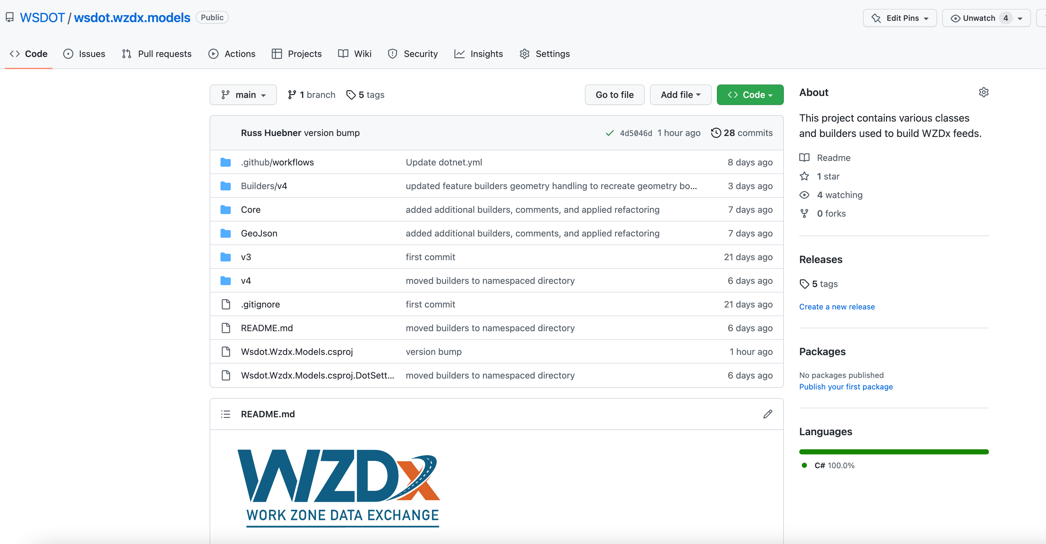
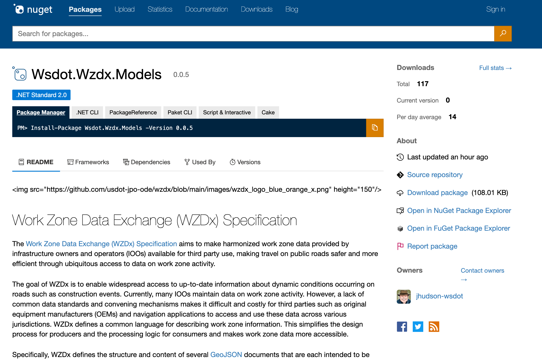
WZDx .NET Core Library Demo
Notes:
New 3rd party library, will be hosting the client source code in github so technical folks can browse. Are also pushing to host it in nuget, so any developer can easily pull it into their project.
Demo how it works with our WZDx builder functionality that will make sure a valid feed is created.

Slide 37
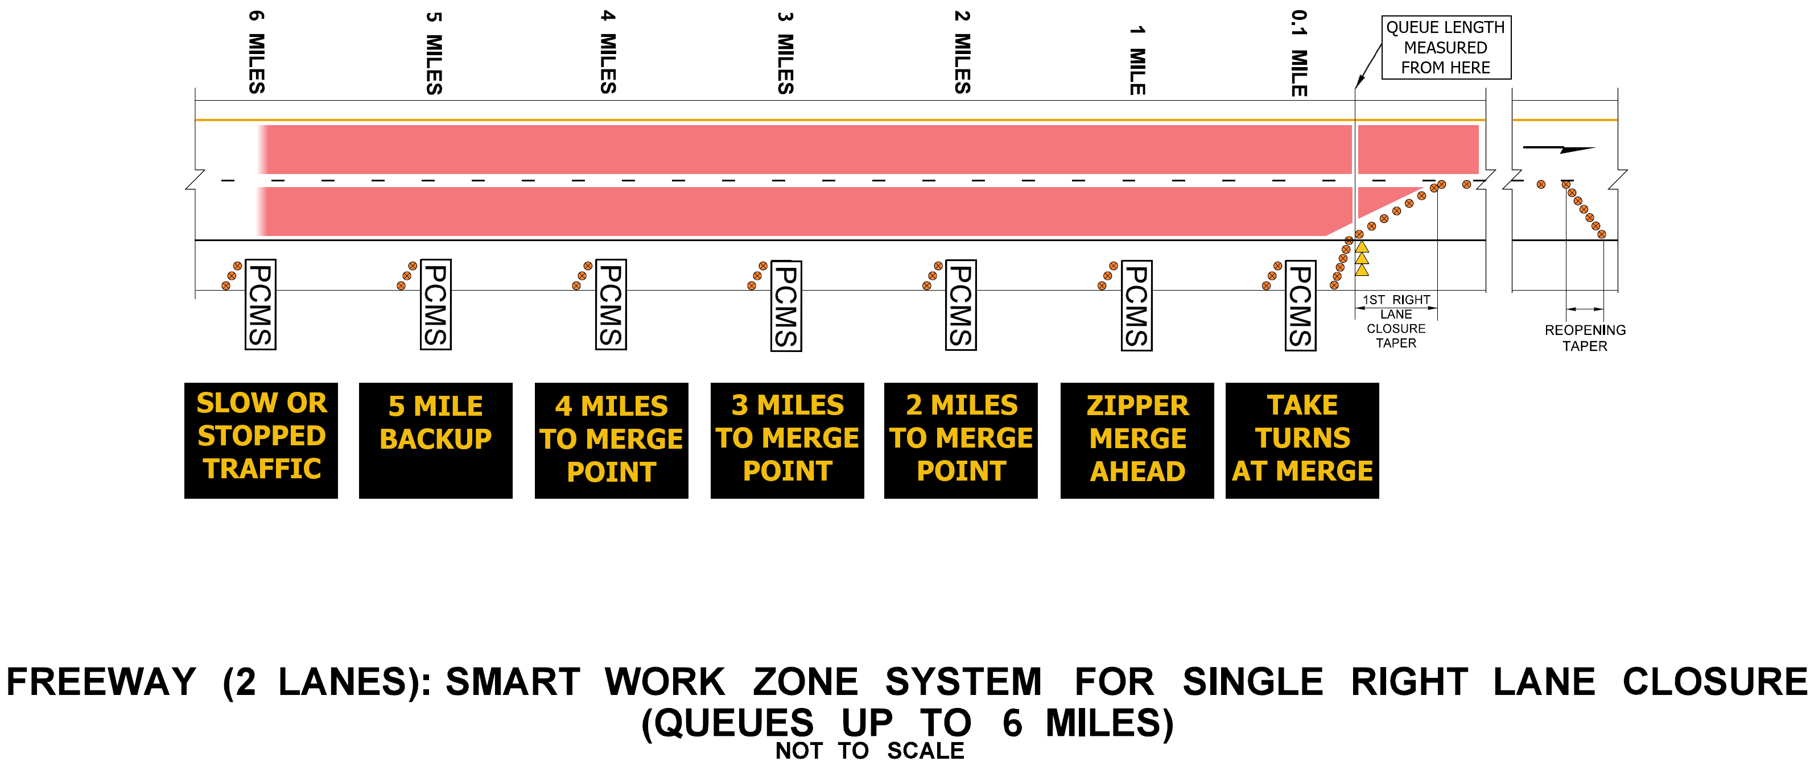
Other WSDOT Smart Work Zone Practices
Innovative PCMS use and queue management/smart work zone specifications
GSP for requiring smart arrow boards on all interstate projects

Slide 38
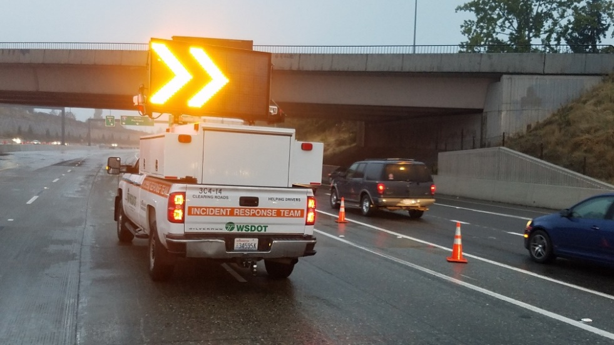
Questions?

Slide 39
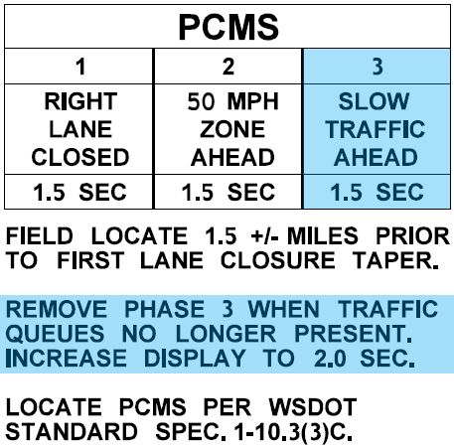
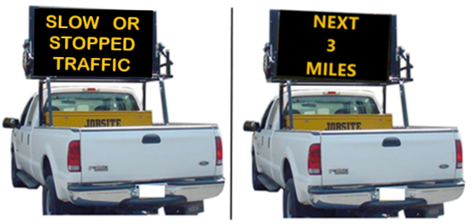
Work Zone Queue Mitigation Strategies
3-Phase PCMS
Adds a 3rd phase to PCMS when queues are present
When queues dissipate, change back to 2 phases @ 2 second display
For intermittent WZ queuing that dissipates, up to 1.5 miles
Truck-Mounted PCMS
Work vehicle moves up and down shoulder remaining ½± mile upstream of queue
Remove vehicle when queue dissipates
For intermittent WZ queueing over 1.5 mile (when extending behind PCMS)
4-22
Notes:
The first mitigation is to use a 3-phase PCMS with “SLOW TRAFFIC AHEAD” message that is displayed about 1.5 miles in advance of queues. If queues extend behind this PCMS, then adding a truck-mounted PCMS that moves up and down the right shoulder, remaining about ½ mile in advance of the queue, can be used. When the queues dissipate back in front of the PCMS, the truck-mounted PCMS can be removed.

Slide 40
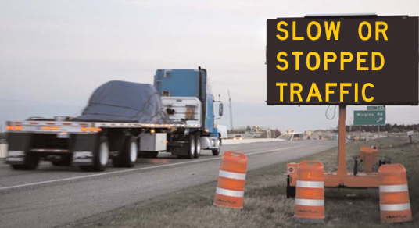
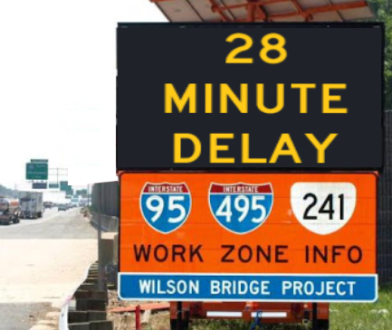
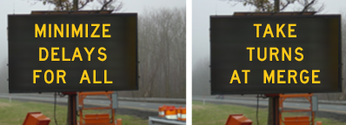
Work Zone Queue Mitigation Strategies
Queue Warning System
Simple traffic queue warning messages in real-time
For intermittent WZ queuing that dissipates, up to 2-3 miles
Smart Work Zone Systems
Traffic queue warning
Zipper merge
Travel delay
For regular, reoccurring 6+ mile WZ queues
4-23 to 4-24
Notes:
These systems will begin showing up on new WSDOT projects, but are typically limited to freeway usage where queues exceed 2 miles on a regular basis (even if just for a few hours a day/night).
Queue Warning Systems are simpler versions of Smart Work Zone Systems with fewer PCMSs and traffic sensors meant for typical lane closures that move around nightly (think of paving projects); whereas, Smart Work Zone Systems are more complex and meant for closures that remain in the same location for long durations.

Slide 41
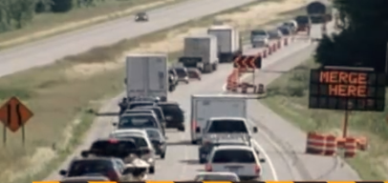
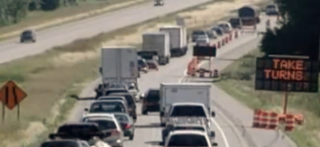
Smart Work Zone Systems
Zipper merge
Traffic queue warning
Travel delay
For regular, reoccurring queues of 6-9 miles
Traffic Queue Warning
“Zipper Merge” Messaging
Travel Delay Information
4-11
Notes:
These systems help inform motorists (especially large trucks) of work zone queues to help reduce occurrences of high-speed rear end collisions. These systems will begin showing up on new WSDOT projects, but are typically limited to freeway usage where queues exceed 1 mile.
Queue Warning Systems are simpler versions of Smart Work Zone Systems with fewer PCMSs and traffic sensors.

Slide 42
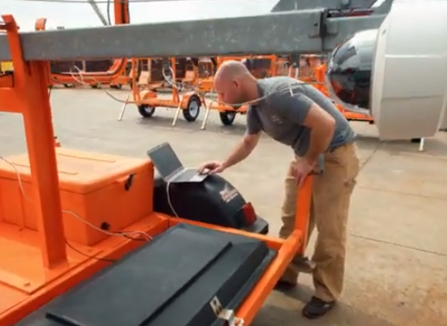
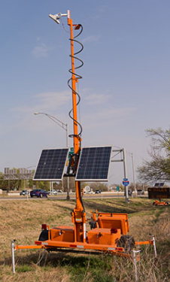
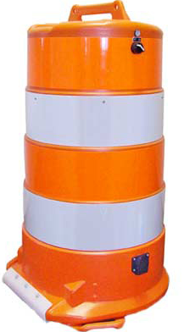
Smart Work Zone Systems
7+ PCMSs & 6+ Traffic Sensors
2 Portable Time Readers
~ $600 / work shift
For regular, reoccurring queues of 6-9 miles
SWZS Technician
Independent of Contractor/Sub
Collaborates with TCS
Independent Vendors
List of approved vendor in GSP
Provides Technician Training
May Provide Equipment
Trailer-Mounted
Traffic Sensor
Traffic Safety Drum with Traffic Sensor
Notes:
These systems help inform motorists (especially large trucks) of work zone queues to help reduce occurrences of high-speed rear end collisions. These systems will begin showing up on new WSDOT projects, but are typically limited to freeway usage where queues exceed 1 mile.
Queue Warning Systems are simpler versions of Smart Work Zone Systems with fewer PCMSs and traffic sensors.

Slide 43
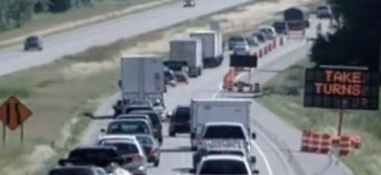
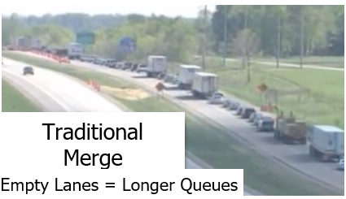
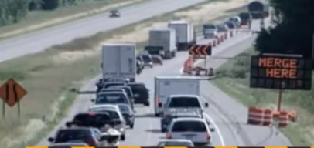
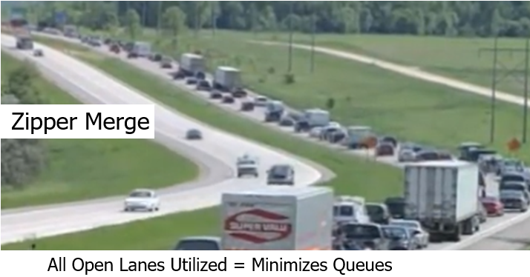
“Zipper Merge”
Use all open lanes up to merge point
At merge point, take turns
“Zipper Merge” Messaging

Slide 44
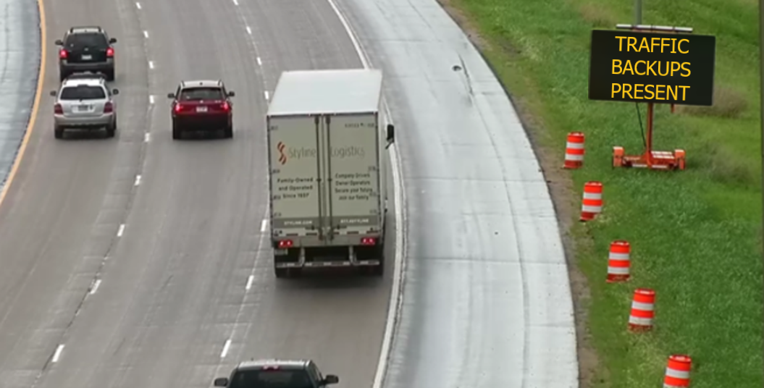
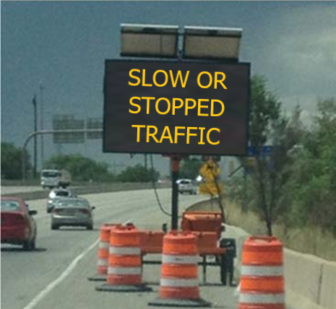
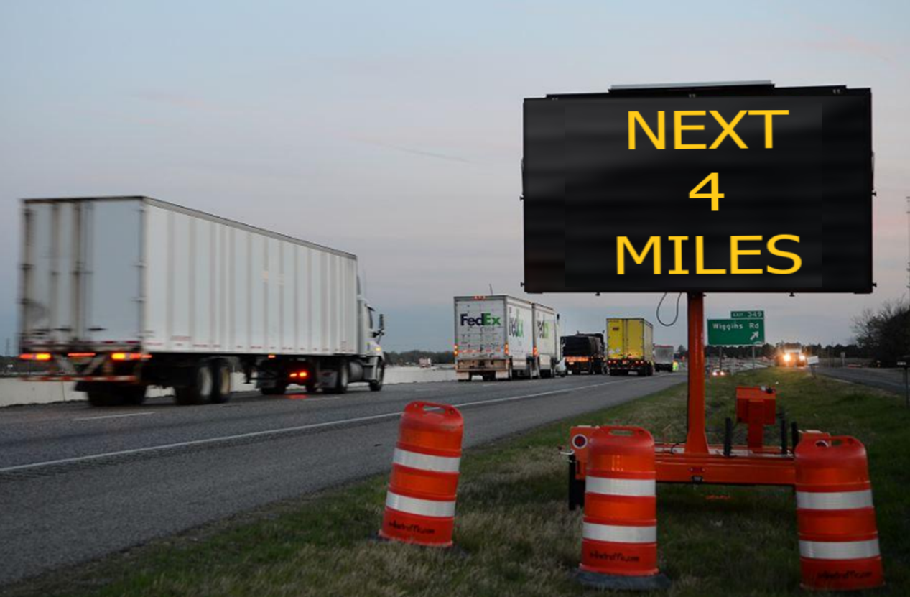
Queue Warning
Informs of slow or stopped traffic conditions

Slide 45
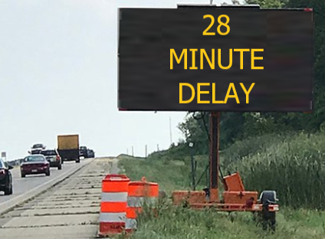
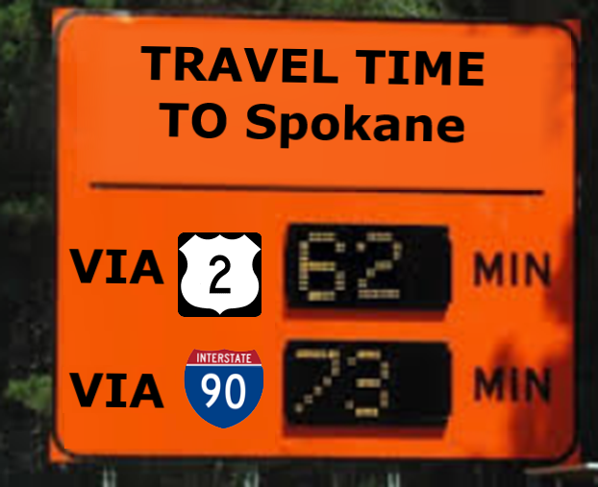
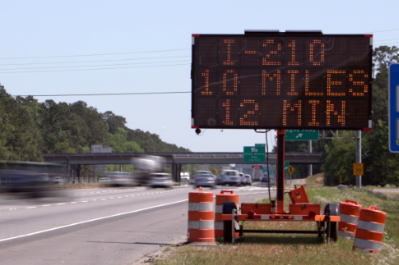
Travel Delay
Current delay through work zone in minutes
Travel Time Alternative

Slide 46
Smart Work Zone System
General Special Provision
  Specification, Measurement (Bid Item, LS), Payment
Bid Items
  “Operation of Smart Work Zone System” (hour)
    Mobilization will be incidental
  “Other Traffic Control Labor” (hour)
  “Portable Changeable Message Sign” (hour)
8 Typical Traffic Control Plans in Library
    6-mile queues (TC165 & TC166)
    9-mile queues (TC175 & TC176)

Slide 47
Smart Work Zone System
Estimated Cost
  Operation of SWZS & PCMSs
    24/7 for 21 days: $150/hour
    24/7 for 7 days: $300/hour
    Daily/Nightly: $600/hour
  Other Traffic Control Labor
    Setup: Crew of 5 @ 2 hours = $500
    Removal: Crew of 5 @ 1 hour = $250

Slide 48

Planned/Future Activities

Slide 49

Smart Work Zone System Example
System Setup

Slide 50

Smart Work Zone System Example
No Traffic Queues: Free-flow traffic conditions

Slide 51

Smart Work Zone System Example
No Traffic Queues: Free-flow traffic conditions

Slide 52

Smart Work Zone System Example
Traffic Queue: Forms at Merge
End of queue warning begins

Slide 53

Smart Work Zone System Example
Traffic Queue: Forms at Merge
End of queue warning begins

Slide 54

Smart Work Zone System Example
Traffic Queue: Increasing, Less than 0.9 Mile

Slide 55

Smart Work Zone System Example
Traffic Queue: Increasing, Less than 0.9 Mile

Slide 56

Smart Work Zone System Example
Traffic Queue: Increasing, Approaching 0.9 Mile Traffic Sensor

Slide 57

Smart Work Zone System Example
Traffic Queue: Increasing, Approaching 0.9 Mile Traffic Sensor

Slide 58

Smart Work Zone System Example
Traffic Queues: Increasing, Beyond 0.9 Mile Traffic Sensor
Zipper merge begins
Travel delay begins

Slide 59

Smart Work Zone System Example
Traffic Queues: Increasing, Beyond 0.9 Mile Traffic Sensor
Zipper merge begins
Travel delay begins

Slide 60

Smart Work Zone System Example
Traffic Queues: Increasing, 1.9 - 2.9 Miles
Lane usage instructions begin

Slide 61

Smart Work Zone System Example
Traffic Queues: Increasing, 1.9 - 2.9 Miles
Lane usage instructions begin

Slide 62

Smart Work Zone System Example
Traffic Queues: Increasing, 2.9 - 3.9 Miles

Slide 63

Smart Work Zone System Example
Traffic Queues: Increasing, 2.9 - 3.9 Miles

Slide 64

Smart Work Zone System Example
Traffic Queues: Increasing, 3.9 - 4.9 Miles

Slide 65

Smart Work Zone System Example
Traffic Queues: Increasing, 3.9 - 4.9 Miles

Slide 66

Smart Work Zone System Example
Traffic Queues: Increasing, 4.9 - 6 Miles

Slide 67

Smart Work Zone System Example
Traffic Queues: Increasing, 4.9 - 6 Miles

Slide 68

Smart Work Zone System Example
Traffic Queues: Peaks @ 6 Miles, Begins Decreasing

Slide 69

Smart Work Zone System Example
Traffic Queues: Peaks @ 6 Miles, Begins Decreasing

Slide 70
Smart Work Zone System Example
Traffic Queues: Decreasing, 6 – 4.9 Miles

Slide 71
Smart Work Zone System Example
Traffic Queues: Decreasing, 6 – 4.9 Miles

Slide 72
Smart Work Zone System Example
Traffic Queues: Decreasing, 4.9 - 3.9 Miles

Slide 73
Smart Work Zone System Example
Traffic Queues: Decreasing, 4.9 - 3.9 Miles

Slide 74
Smart Work Zone System Example
Traffic Queues: Decreasing, 3.9 - 2.9 Miles

Slide 75
Smart Work Zone System Example
Traffic Queues: Decreasing, 3.9 - 2.9 Miles

Slide 76
Smart Work Zone System Example
Traffic Queues: Decreasing, 2.9 - 1.9 Miles

Slide 77
Smart Work Zone System Example
Traffic Queues: Decreasing, 2.9 - 1.9 Miles

Slide 78
Lessons Learned – Technical Considerations
Standards:
Communicating geometry/geography differs between agencies and companies
  Translation may be required, spatial references checked, and projection required
Version 4.0 pushes to dynamic data structures which can be more challenging to adopt in a more static language like c#. Other languages like JavaScript handle dynamic structures better
Data feeds/storage:
Should data pull from the sources and go right out to the feed or ETLs written to transfer data:
  Lots of outside sources (internal and device vendors)
  Some vendors publish today in WZDx and others do not
Hosting architecture and the choice to migrate to cloud
Notes:
The choice to go to the cloud allows us to scale based on adoption. It also aligns well with the IT Divisions Strategic Goal of continuous modernization.

Slide 79
Background – 1st Gen WZDB
Problem:
Conflicts between construction and maintenance operations
Missing reliable public information
Solution: WSDOT’s original Work Zone Database (WZDB) –
1st Generation developed in early 2000s
Provided a way to plan and coordinate work zone impacts in advance
Results:
Conflict avoidance through better coordination using the WZDB
Opportunities to combine multiple work zone activities and reduce driver impacts – better and more available public information

Slide 80
Common Terminology
ADS – automated driving systems
CAT – cooperative automated transportation
CAV – connected/automated vehicles
CIA – Construction Impact Analysis application for external reporting of traffic disruption projects informing local/regional partners of road closures
GeoJSON - a format for encoding a variety of geographic data structures.
IRT – incident response team
NWP – North/West Passage Pooled Fund
SAE – formerly Society of Automotive Engineers, responsible for connected vehicle message type standards
SDX – Situation Data Exchange by Trihydro from Wyoming’s connected vehicle pilot
Trihydro – Private company steward maintaining and developing the technology platform (SDX) created for USDOT’s CV pilot to disseminate WyDOT’s messages
TIM – Traveler Information Message typical of connected vehicle standards (SAE)
TMC – Traffic/Transportation Management Center
Vision Zero – WSDOT’s crash reduction/safety goal/program
WZDB – WSDOT’s work zone database
WZDI – Work Zone Data Initiative
WZDx – Work Zone Data exchange

Slide 81
WZDx–Compliant Feed Development
Started project when WZDx 3.1 was the released version.
Mid-project WZDx 4.0 was released:
WZDx version 4.0 implements clean up and small additions in functionality to the WZDx feed and added the SwzDeviceFeed and RoadRestrictionFeed feeds.
Until version 4.0, the WZDx specification defined only one feed, the WZDxFeed.
4.0 was a significant change and added time to our project to adopt the new standard. However, it was important for us to launch our effort using the latest version of the feed.
Our data consumers may not yet support 4.0 so we have endpoints for both 3.x and 4.x versions of the WZDxFeed.
Let’s take a look at each of the feeds and who they are for.

Slide 82
WZDx–Compliant Feed Development
Validation, testing, publishing – What did we do
Created puller processes from our 3 current data sources (WZDB, Construction Impact Analysis Application and a vendor device [Pi-lit] to pull all data that will go out in the feed into a shared database that always holds the current data going out in the view.
We don’t store historical information in this database, that data is the responsibility of the source system, so the database and feed should always show the current and planned data.
Created a WZDx validator for feed validation and testing, based off the schema provided by the WZDx project.
Created code models to be able to build up a WZDx feed in both 3.x and 4.x specifications. These allow us to publish a feed. More on this later in this presentation.
WSDOT will be hosting our final WZDx feed in our Azure cloud environment.

Slide 83
WZDx–Compliant Feed Development – Cloud Hosting
From WZDx:
Though all DOTs have infrastructure capabilities to host a WZDx feed, it is recommended that the feed be cloud hosted on a trusted platform due to the following reasons:
Security: Trusted cloud hosted providers such as Amazon Web Services, Google Cloud Platform, and Microsoft Azure all have hardened physical security as well as digital security best practices already in place.
Dedicated Denial of Service (DDoS) Prevention: DDoS attacks remain a very common form of hacking that are still used today. Cloud providers have built solid solutions that can handle DDoS attacks and prevent downtime.
Scalable: As WZDx feeds become more widely used, they may be hit much more frequently than other endpoints. Cloud hosting allows DOTs to easily scale to accommodate for more hits or usage of the endpoint.
Load Balancing Solutions: Along with scaling physical hardware, load balancing allows DOTs the ability to scale the number of endpoints serving up WZDx data feeds.
For WSDOT: The cloud is a big part of our continuous modernization strategic goals so when releasing a new data feed the Cloud was a logical hosting platform.

Slide 84

WZDx–Compliant Feed Development – 3.x Architecture

Slide 85

WZDx–Compliant Feed Development – 4.x Architecture

Slide 86
Lessons Learned – Start with what works and build on that
What worked:
Communicate and collaborate along the way
  WSDOT established a TSMO Subcommittee on Work Zones in January 2021
    Completed an initial Capability Maturity Framework to understand ourselves
    Forum for sharing information on available technologies as they develop
    Institutionalize collaboration across all Divisions and Regions of the agency
    Prepare our agency for CAT Technologies of the future
    Update agency manuals, specifications, and guidance for work zone tools
  Talk to vendors early and often
What didn’t work:
Timelines – be flexible
Plans – be adaptable
Notes:
Probably need to expand into 2 slides

