Slide 1
Leveraging Automation for Mobility and Safety Solutions
ITS Washington, December 14, 2022
Hicham Chatila, PE, TE, PTOE

Slide 2
Outline
The case for automation
Examples
Data Collection
Safety Studies
Signal Priority
Digital Twins
Considerations

Slide 3
Business Process Automation
A first thought, not an afterthought

Slide 4
Business Process Automation
Use Case Development
AUTOMATION
Technology Integration
Workflow Design

Slide 5
The case for automation
Manual Data Collection
Existing Conditions
Analysis
Existing Conditions
Develop and Implement Improvements
Manual Data Collection
Future Conditions
Analysis
Future Conditions
Project scope, goals, and objectives
Automated data collection
Existing Conditions
Automated Analytics
Existing Conditions
Develop and Implement Improvements
Automated Data Collections
Future Conditions
Project scope, goals, and objectives
Automated Analysis
Future Conditions
Current Approach
Proposed Approach

Slide 6
Data Collection

Slide 7
Current Practice
Collection
Verification
Reduction
Storage
Analysis
Reporting
Before
Collection
Verification
Reduction
Storage
Analysis
Reporting
After
Analysis

Slide 8
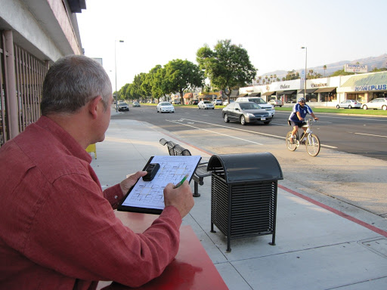
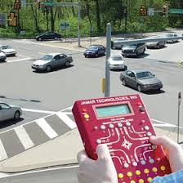
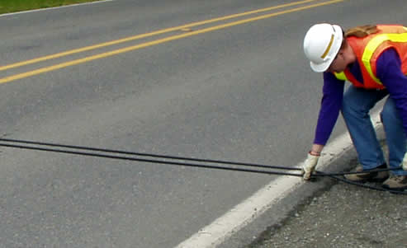
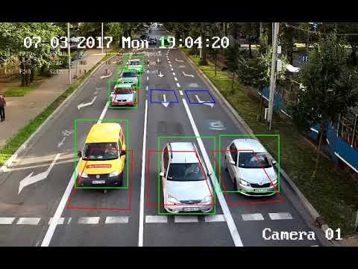
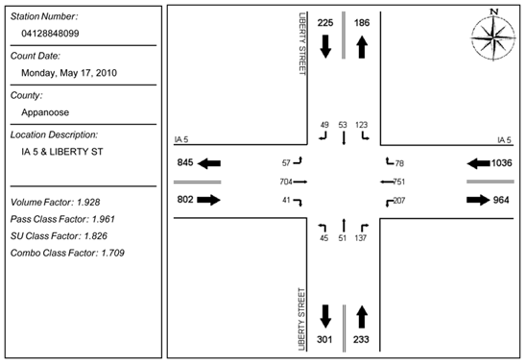
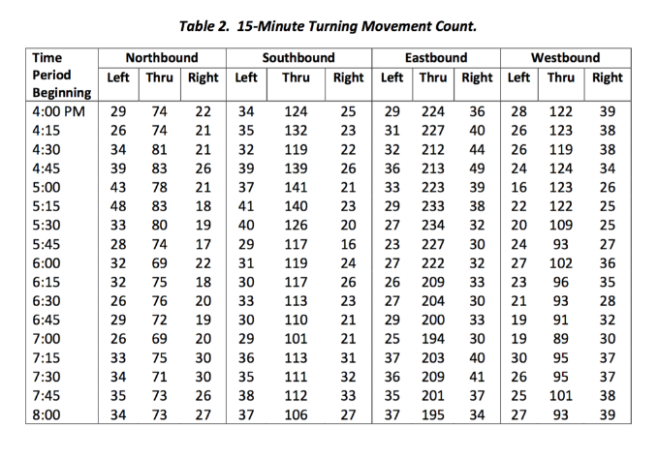
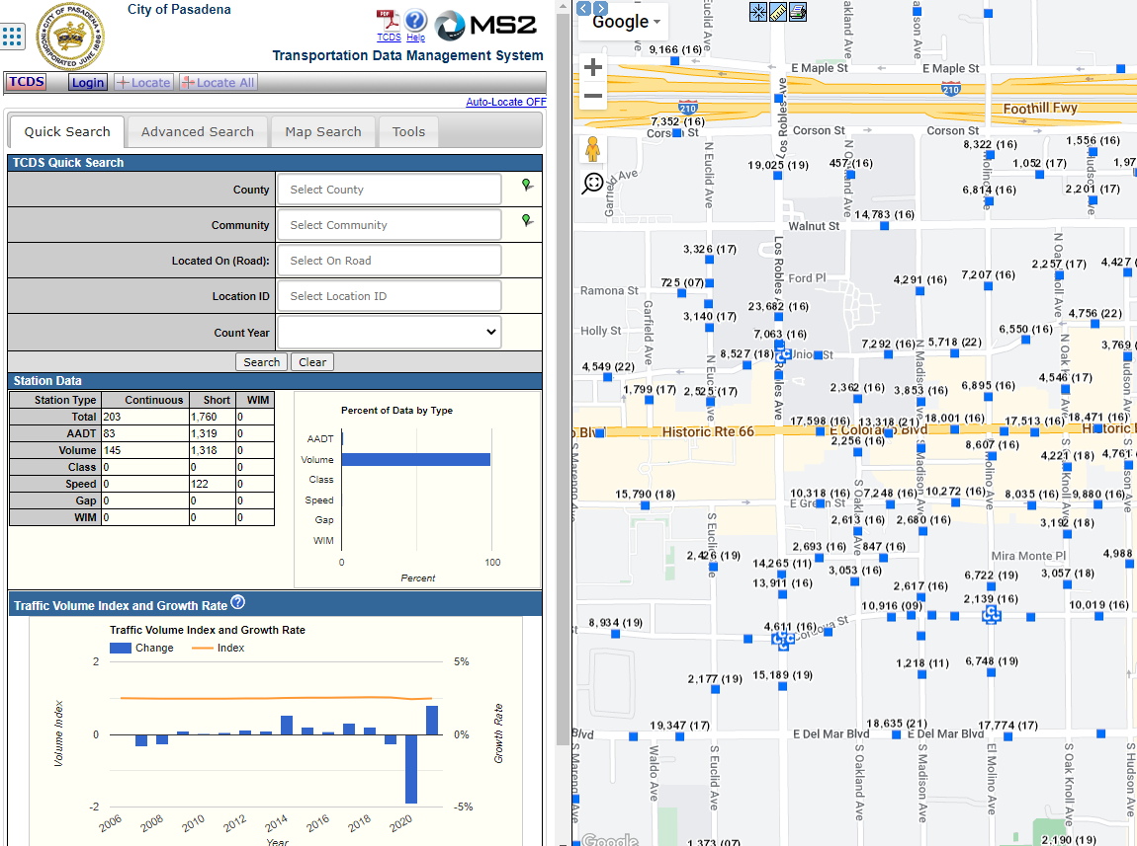
Current Practice

Slide 9
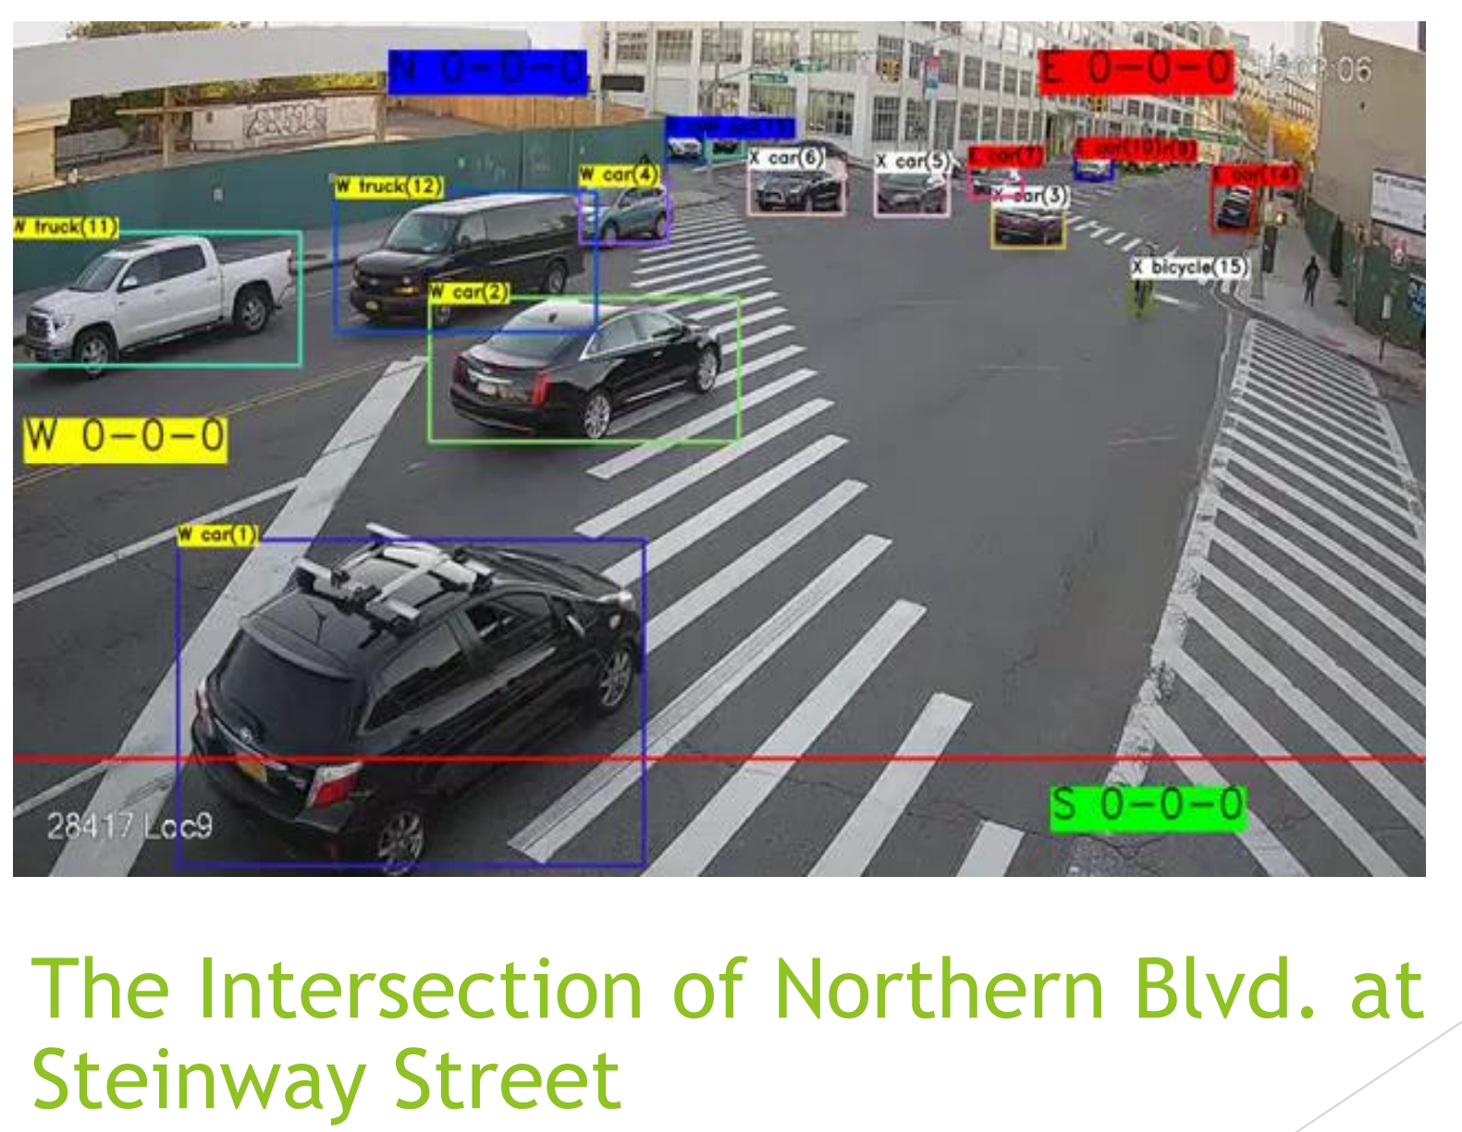
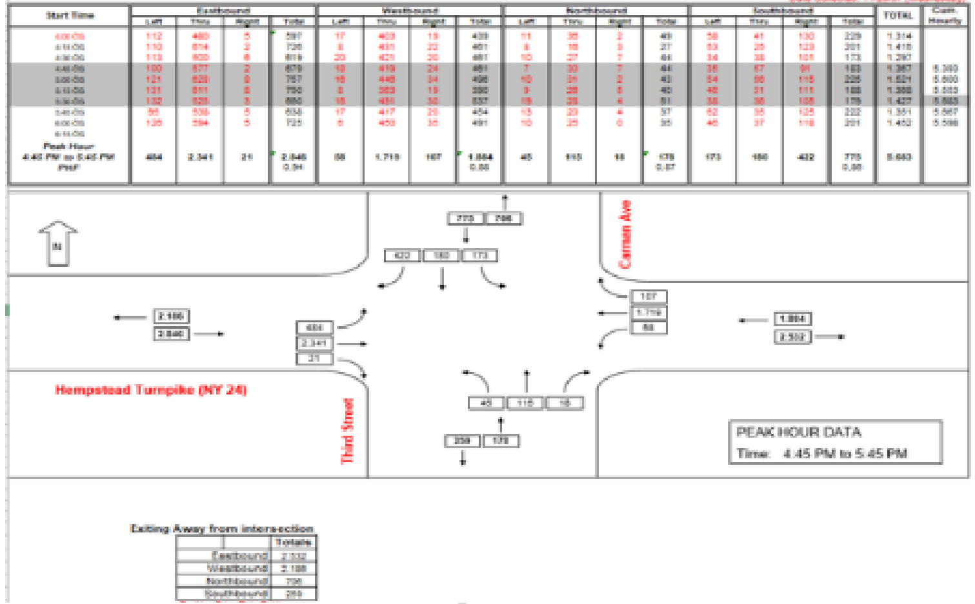
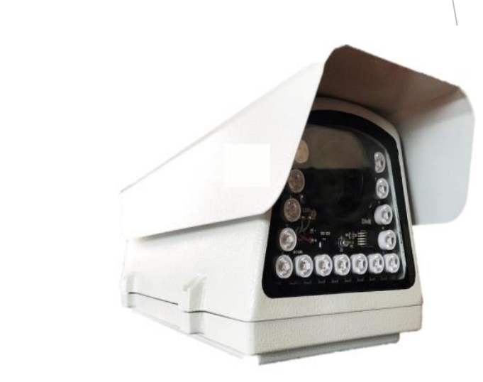
Automated data collection and analytics
Edge Commuting
using Video Camera with Machine Learning built in
Object counting and classification and speeds per FHWA
Automatically generated turning movement, PHF, % peds, and trucks at the edge
Data import, modeling, and analysis

Slide 10
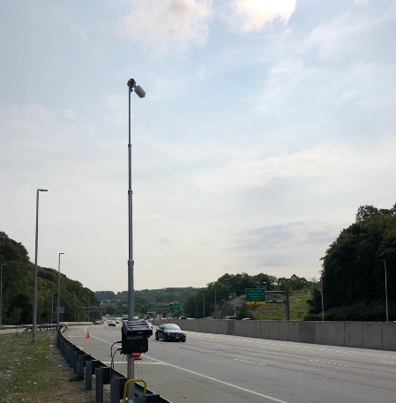
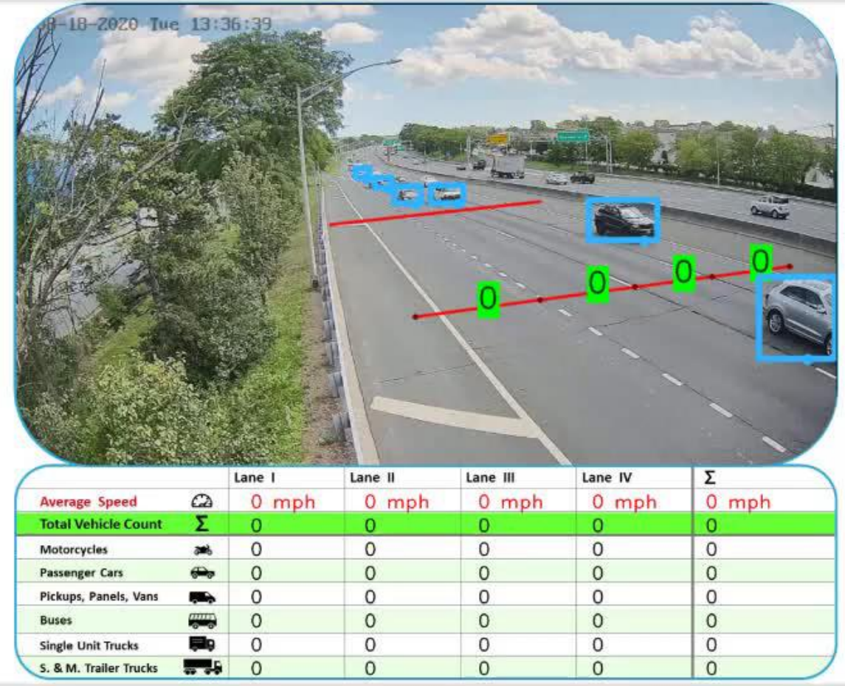
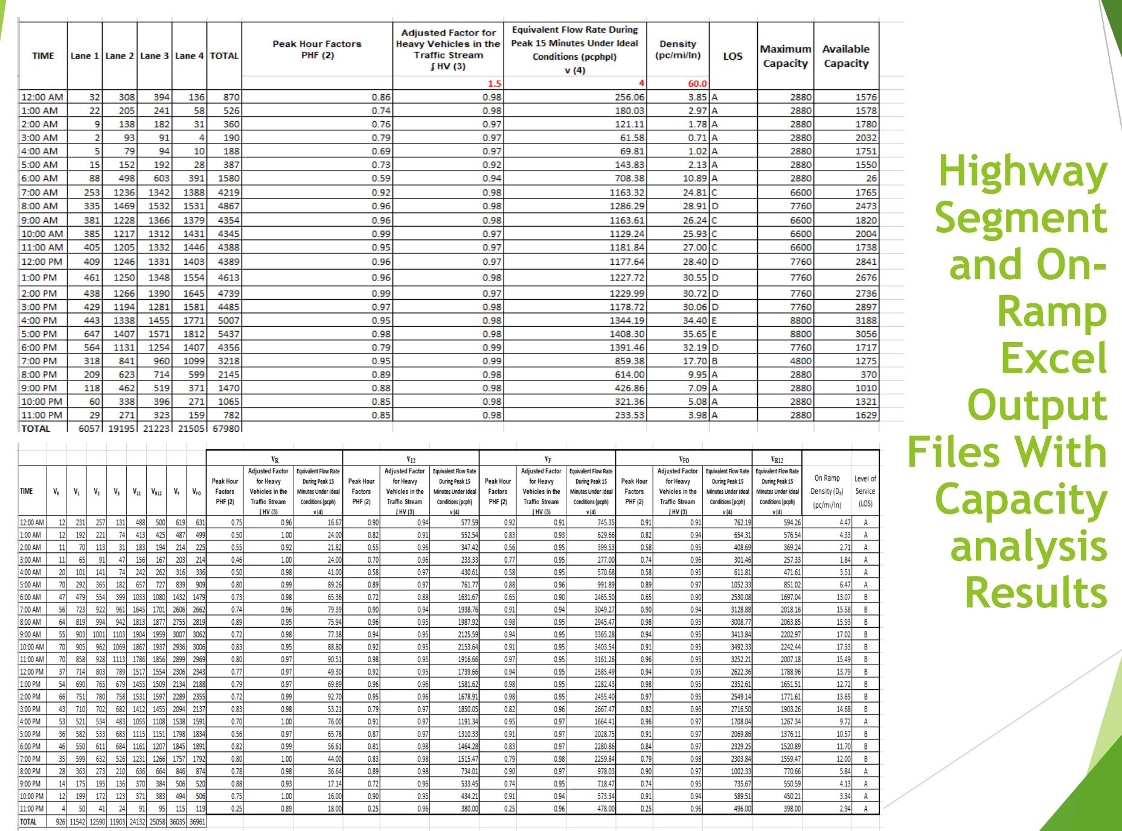
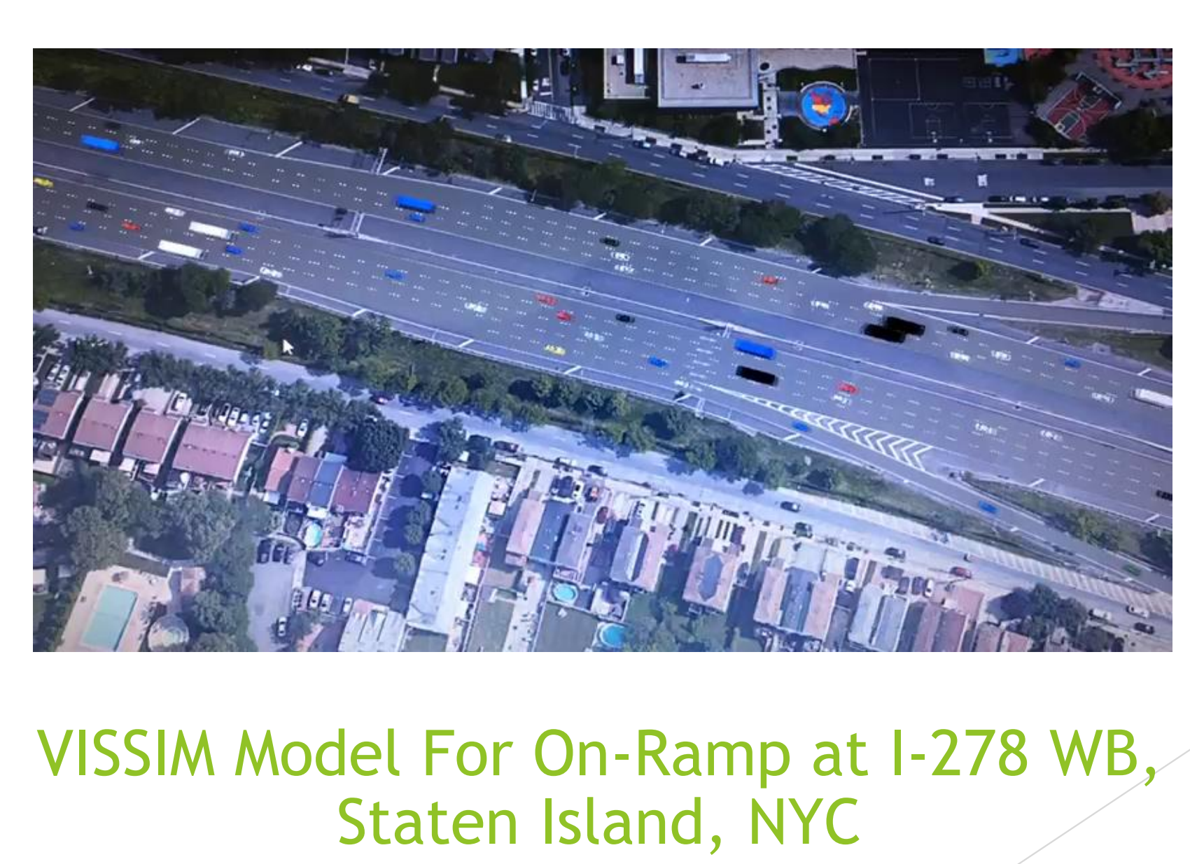
Automated data collection and analytics using AI

Slide 11
Road Safety

Slide 12
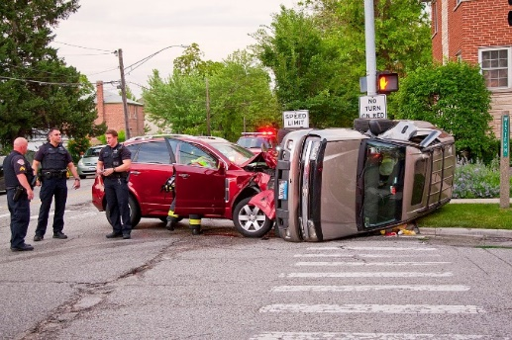
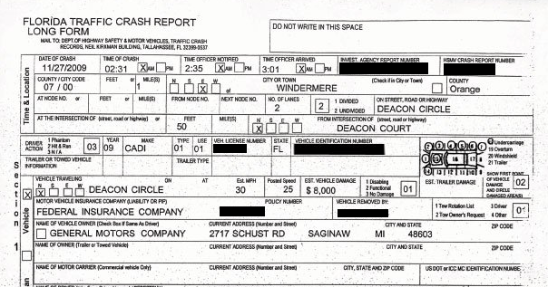
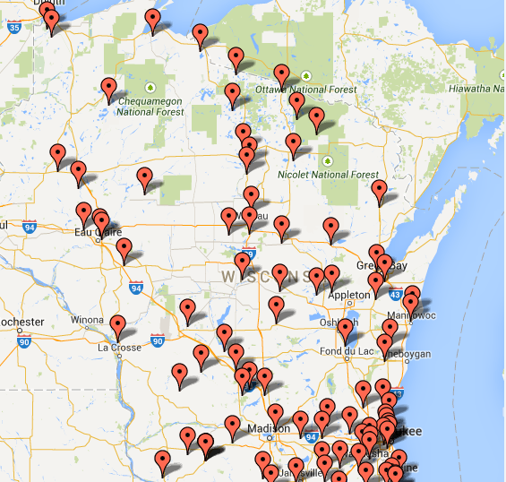
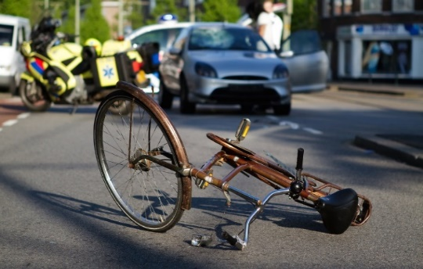
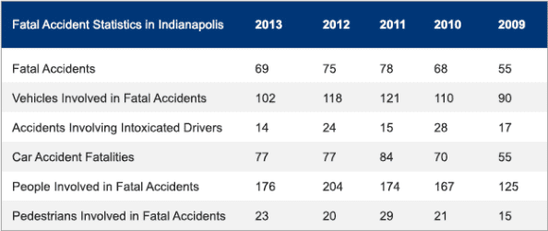
Current Practice

Slide 13
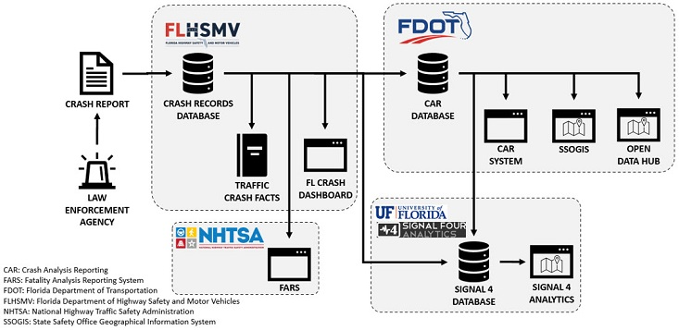
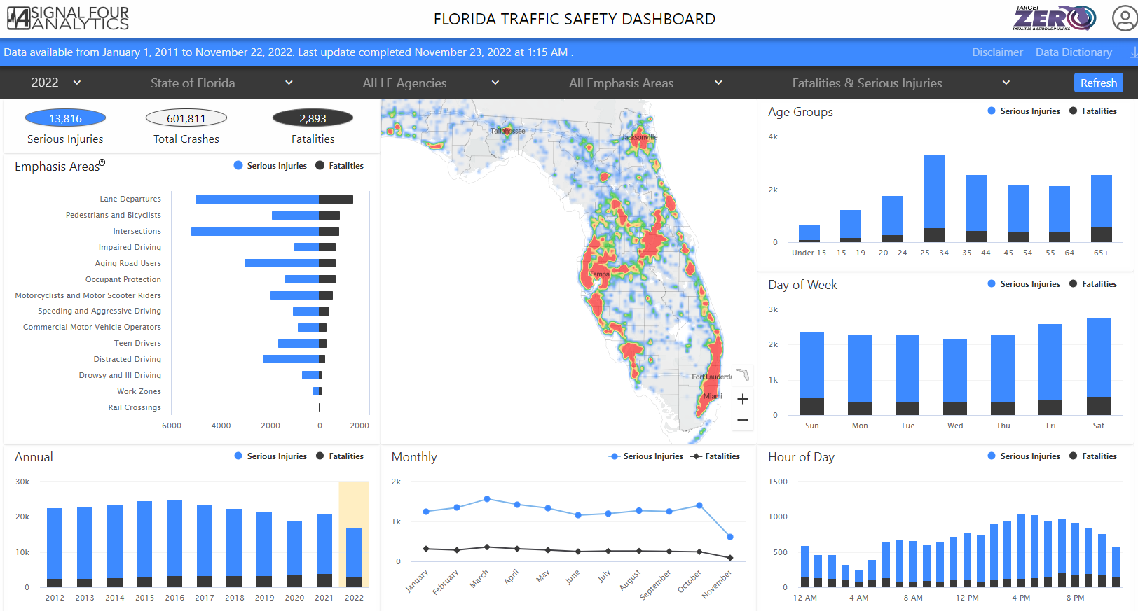
Better Business Process

Slide 14
Automation - leveraging machine learning techniques
Automated Traffic Data
Volumes, TMC, classification, Speeds, travel times, delay, etc.
Road Safety
Near misses, illegal maneuvers, violations, accident forensics, etc.
CAV
Incident management, Crash avoidance, V2X applications

Slide 15
Transit Signal Priority

Slide 16
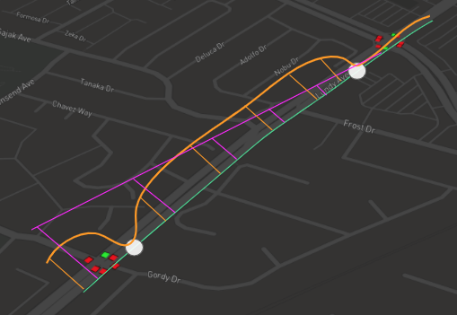
Automation for transit signal priority
The green line indicates the bus travel path
The orange line represents the bus speed
The purple line is the resulting vectorized estimated time to arrival (ETA) based on vehicle speed and bus stop wait time
The Purple line is calculated using AI techniques

Slide 17
Digital Twins

Slide 18
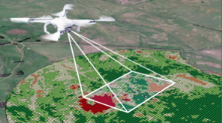
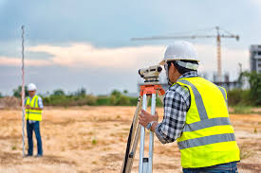
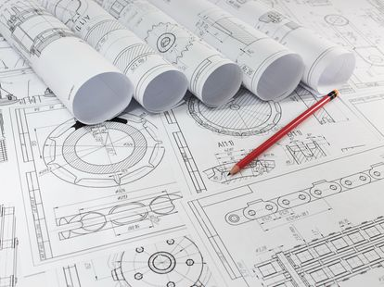
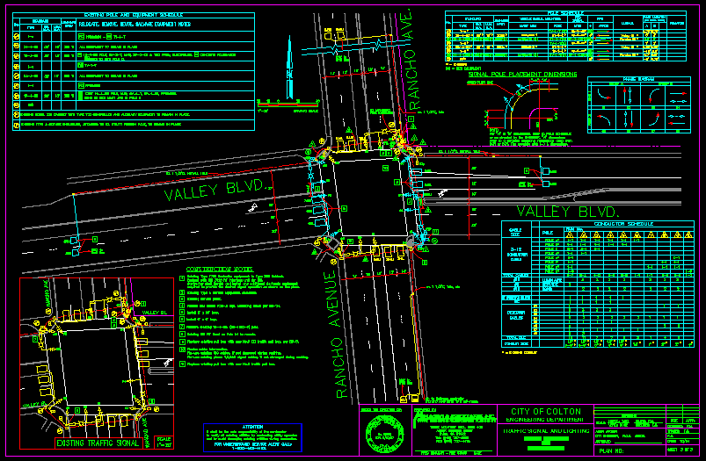
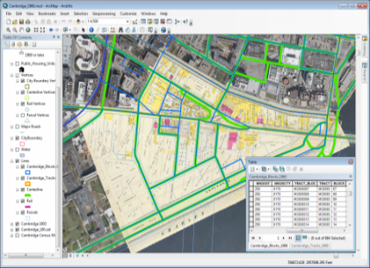
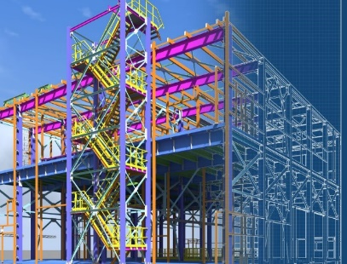
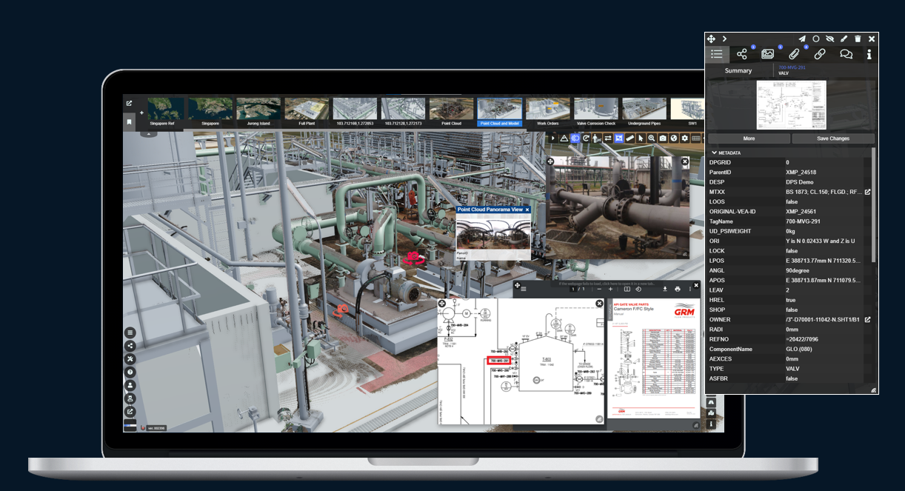
Amalgamation, Integration, and Automation

Slide 19
Digital twins - a journey not a destination
Start Here
Enrich the digital twin with more connected data to go beyond seeing and really understand your assets.
Find patterns and relationships to suggest future possibilities and learn more about your assets.
DESCRIPTIVE
INFORMATIVE
INTERACTIVE
INTELLIGENT
PREDICTIVE
Amalgamate all your existing data to begin to see the whole picture of your assets and database.
Start communicating with a wider range of stakeholders and explore options with your assets.
Join all your data together with AI, machine learning and simulation to predict and optimise your future.
Virtual assets digital twin
Real-time and predictive digital twins

Slide 20
Summary

Slide 21
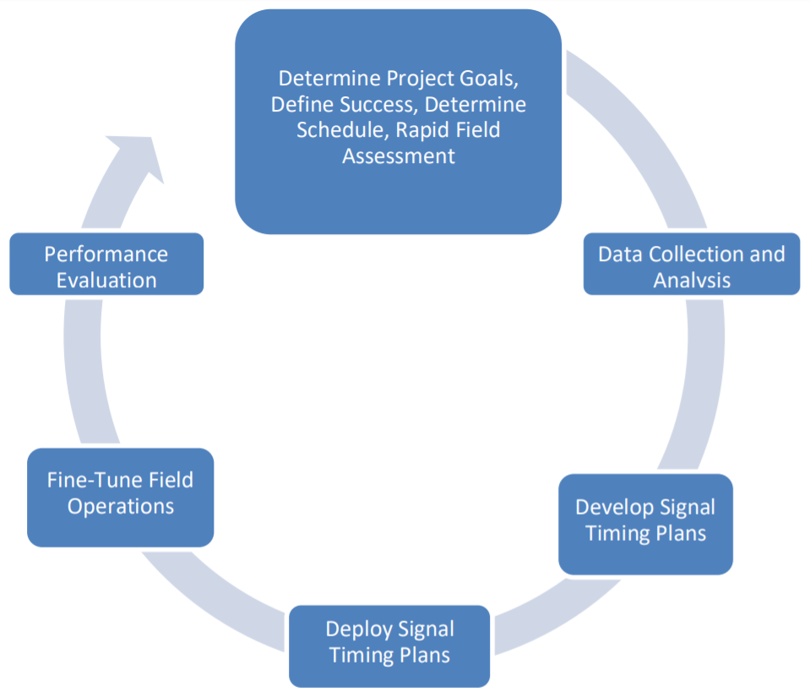
How to start your automation journey

Slide 22
Process Automation Benefits
Reduced Cost
Increased Efficiency
Increased Scalability
Increased Accuracy

Slide 23
Q&A
Hchatila@parametrix.com

