Slide 1
Using Probe Data to Improve our Network
December 14, 2022

Slide 2
Agenda
Define probe data used by SDOT
Describe how we verified data quality
Describe actual use cases

Slide 3
Probe Data: Vehicle speed and travel time
Data from millions of connected vehicles from leading auto companies, including Daimler, Audi/VW, BMW, Ford, etc.
Also: GPS providers, in-vehicle navigational services, trucking companies, fleet services providers and mobile-phone companies

Slide 4
U.S. Transportation Agencies using Probe Data to improve decision making
Los Angeles Metro
New York City
Austin, TX
Boston, MA
Colorado DOT
City of Detroit
Idaho DOT
City of Las Vegas
Massachusetts DOT
Maryland DOT
City of Miami
Nevada DOT
Michigan DOT
New Jersey DOT
Arizona DOT
Washington D.C.
Maine DOT
Wisconsin DOT
Alabama DOT
Florida DOT
Utah DOT
North Carolina DOT
City of Bellevue, WA
Georgia DOT

Slide 5
Probe Privacy Implications
Includes no personally identifiable information
Vendors aggregate and anonymize the data before providing it to others
This solution no longer relies on license plates or other unique identifiers collected by SDOT
Per ITD privacy review, the probe data solutions do not meet definition provided in 14.18 as SDOT is only receiving a feed of data that does not include any personally identifiable information and is not analyzing the movements of specific individuals

Slide 6
Probe Data Solution
Supports SDOT's goals of:
Equity - Data covers the entire City so we can reduce bias when prioritizing solutions
Safety - Combining speed and collision history allows a more nuanced response
Low Maintenance – used to maintain 300+ wifi sniffers in signal cabinets, a data feed only needs a web browser
Probe Data: real-time data from connected vehicles, GPS and navigation devices.
Notes:
Car Icon is CC By OliM, FR

Slide 7
Check the Data Quality
Data are only as good as it’s understood and accepted
Travel Time comparison
Floating car
Speed comparison
Pneumatic tubes

Slide 8
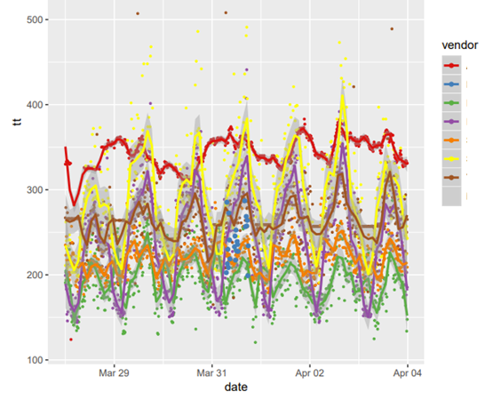
Travel Times
Seven vendor solutions compared with a floating car on four Seattle arterials
Each dataset responds differently to traffic slowdowns
"Performance on the slowdown analysis – the current preferred way to quantify operational performance on arterials – improved dramatically" when comparing probe data from 2013 to 2018.​
-University of Maryland Vehicle Probe Project
Notes:
https://tetcoalition.org/wp-content/uploads/2015/02/I-95-CC-Validation_Arterials_Report-Sep2019-Final.pdf

Slide 9
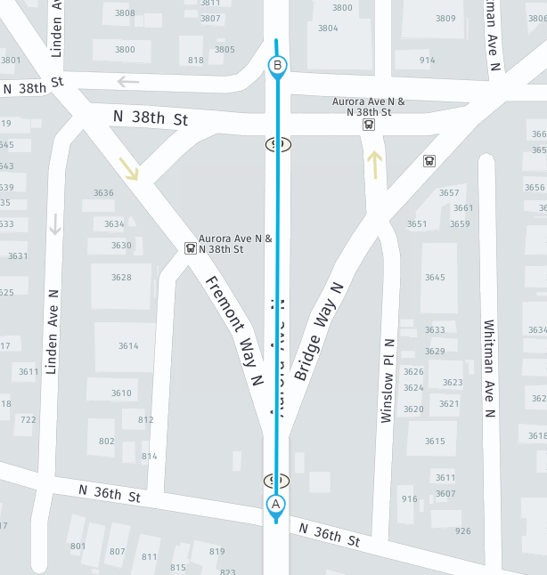
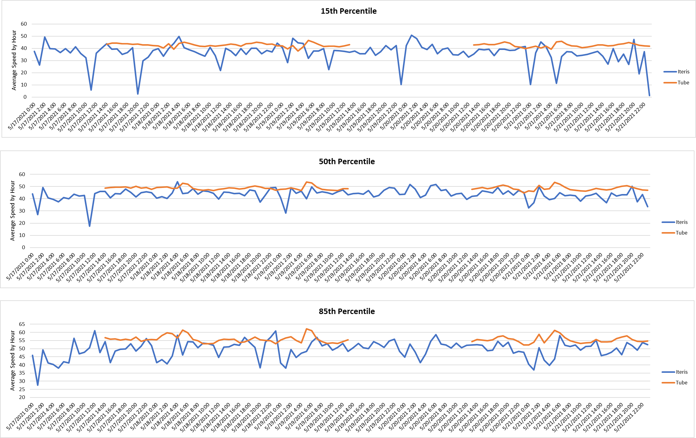
Speed Comparison – urban highway NB, N/O Aurora Bridge
Probe data: 900 foot long “segment speed”
Tube: “spot speed”
85th Percentile speeds averaged 6 MPH less on probe than tube
Notes:
Note hole in tube data with tube up – all data has issues
Note probe data slower over segment speed

Slide 10
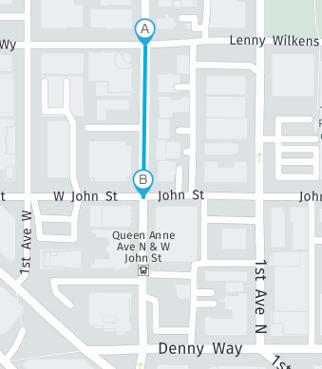
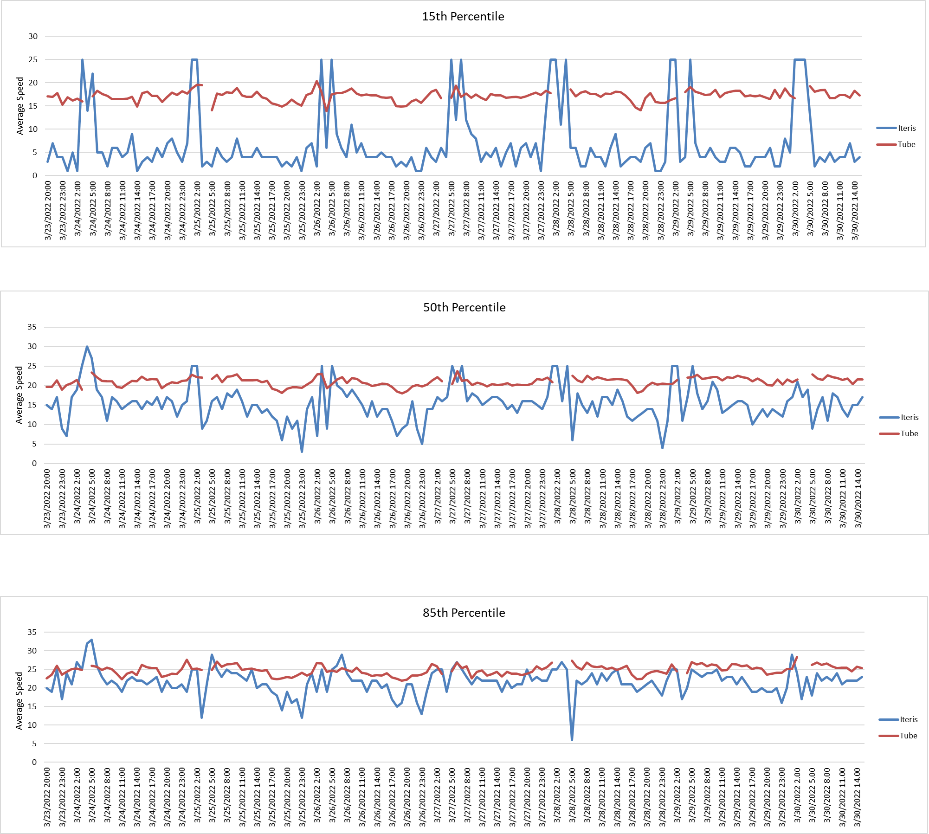
Speed Comparison – dense neighborhood SB, Queen Anne Ave N, N/O John St
Probe: 422 foot long “segment speed”
Tube: “spot speed”
15th and 50th percentile speeds quite different
85th Percentile speeds averaged 4 MPH less on probe than tube
Notes:
2 SB only lanes

Slide 11
Check the Data Quality
Data are only as good as it’s understood and accepted
Travel Time comparison
Found dataset that generally matched a floating car
Speed comparison
85th percentile usually about 5 MPH less than spot speeds

Slide 12
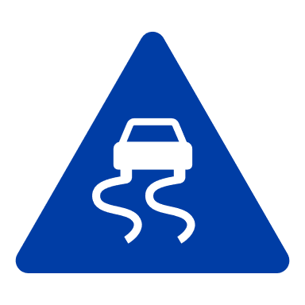
Use Cases
DMS Travel Times
Communicate with the public.
VZ: High Speed Ratio
Understand the relationship between posted and actual speeds.
Reliability Index
Measure the extent of unexpected delays.
Before/After Analysis
Review behaviors before and after changes are made.
Notes:
Not listed – grant proposals – easier to quantify the problem

Slide 13
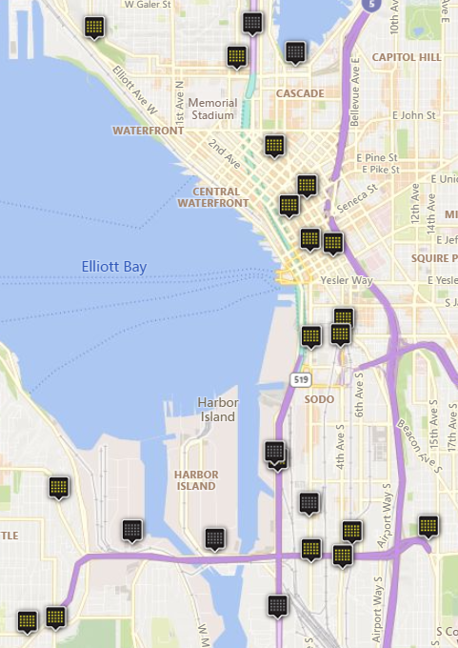
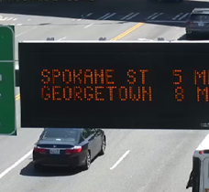
Use Case: Inform the Public
38 Dynamic Message Signs
2-4 travel times per sign
Real-time updates
Flexible routing
Reliable data
Notes:
Updated every minute
Travel times can be measured exactly where we need them, not dependent on installing sensors
Highly reliable data flow, no longer reliant on physical sensors working

Slide 14
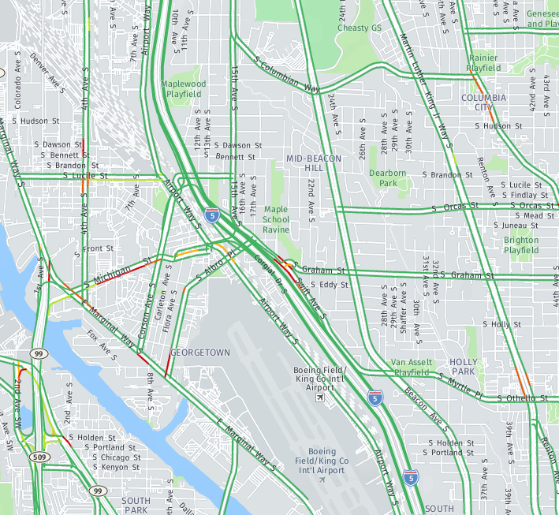
Vision Zero: Lower Speeds to Save Lives
Full knowledge of vehicle speeds, citywide enables equitable decisions
Can compare to speed limits and our collision data to target Vision Zero efforts

Slide 15
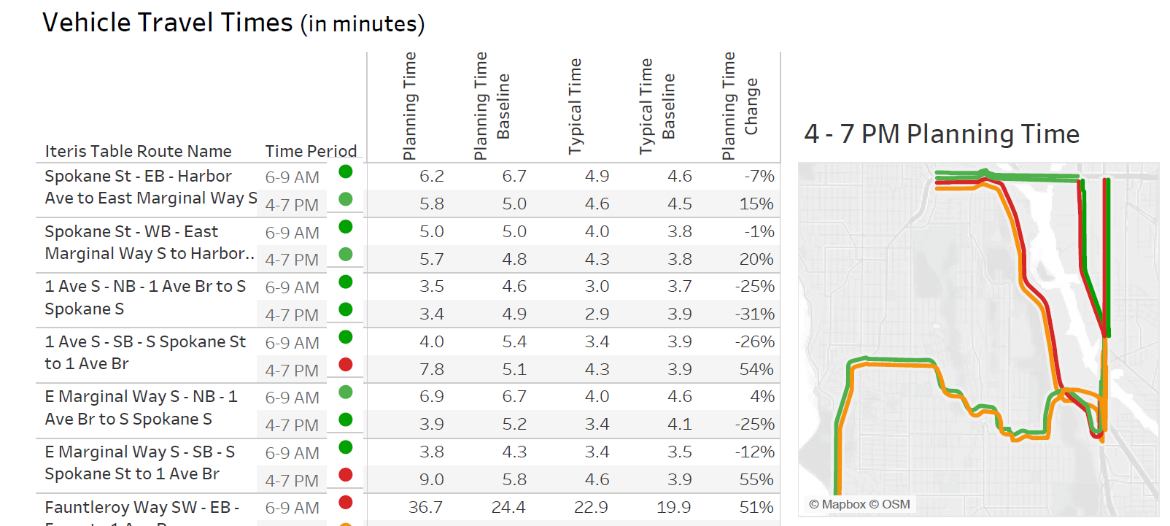
Use Case: Monitor Reliability, Weekly Report
West Seattle Bridge Closed
How are the detour routes working out?
Planning time: 95th percentile
Typical time: median

Slide 16
Use Case: Before/After Study Clear Traffic After Large Events
Full knowledge of vehicle speeds
Can pinpoint slowdowns
Evaluate different traffic management plans
Post Seahawks Game
Notes:
Entering in a partnership with Google to see if they can recommend changes – this data will be key in measuring success in any testing

Slide 17
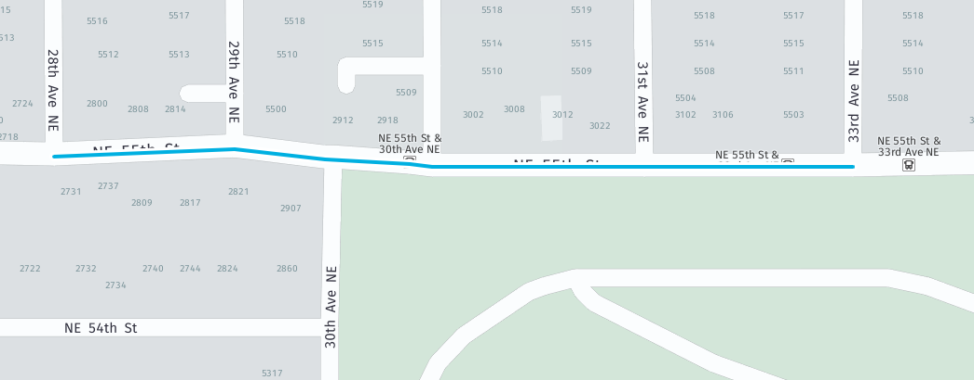
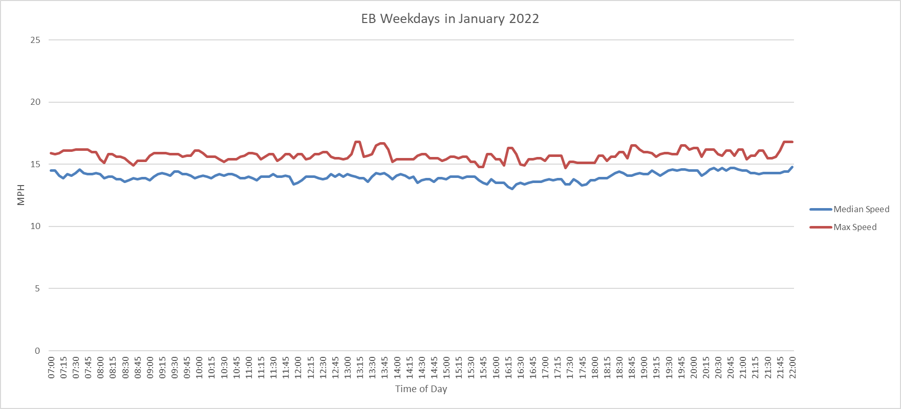
Use Case: Investigate Constituent Concerns
Before/After evaluation possible on all arterials, anytime
NE 55th St between 33rd Ave NE and 28th Ave NE
Weekdays, no holidays, January 2022
7 AM to 10 PM
Speed limit: 25 MPH

Slide 18
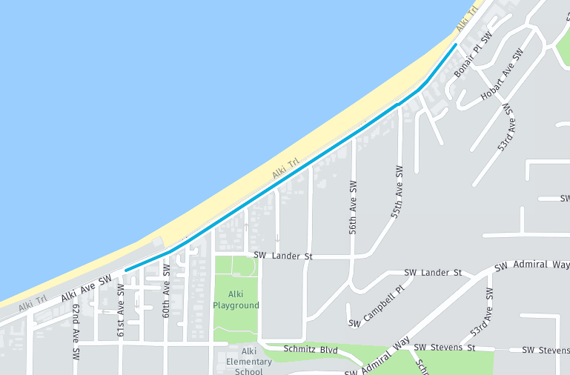
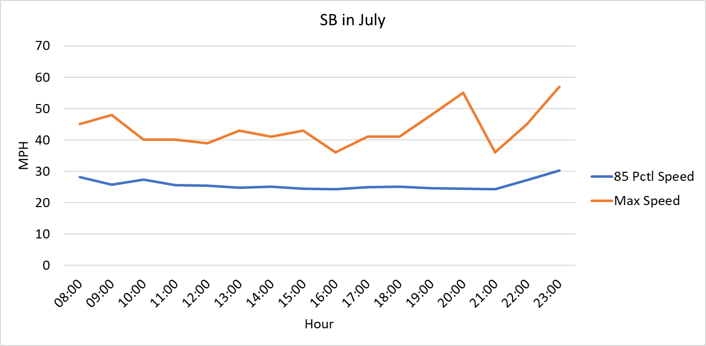
Use Case: Investigate Constituent Concerns
Alki Ave in West Seattle –complaints of summer speeding
Notes:
Speed humps now installed

Slide 19
Thank You Jeffrey Conor Jeffrey.Conor@seattle.gov

